Slide 1
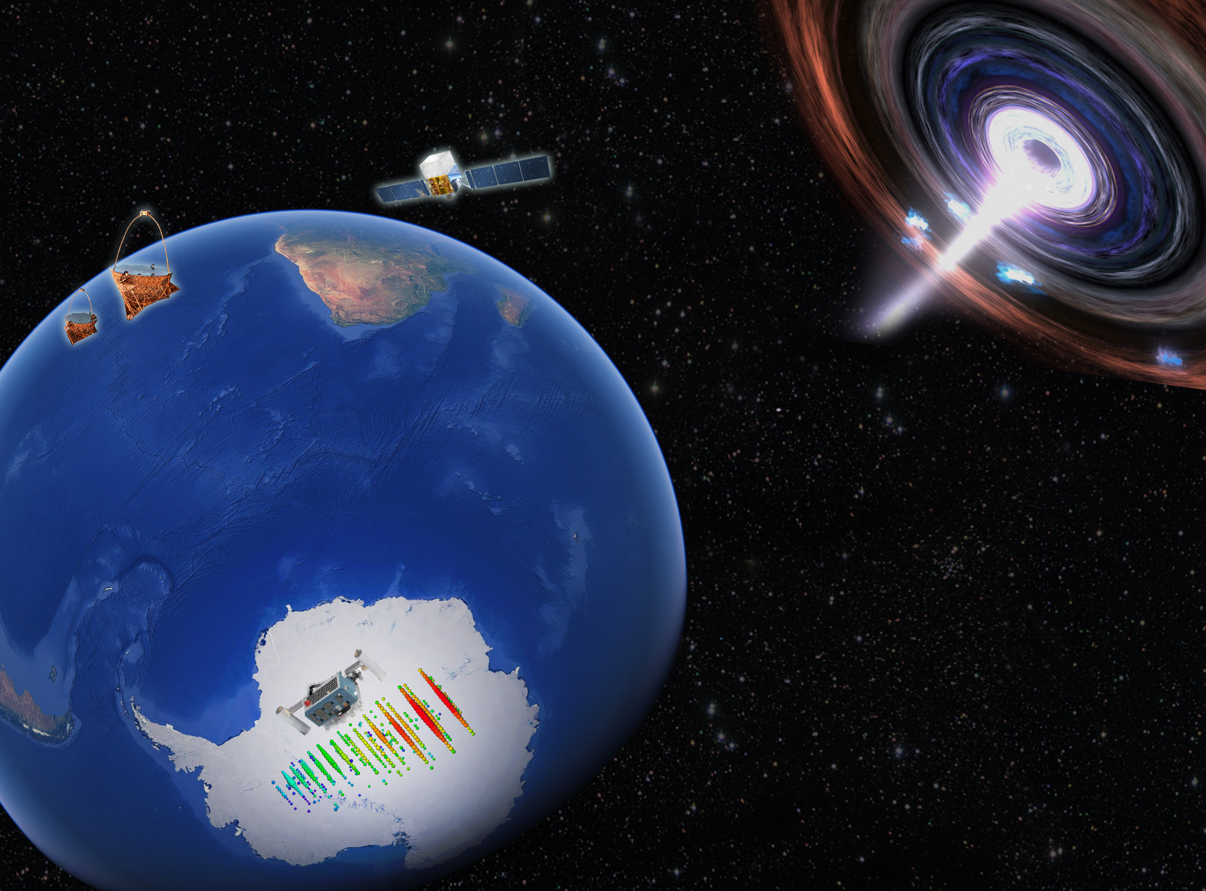


High-energy (astrophysical) neutrinos
Justin Vandenbroucke (University of Wisconsin)
Topics in Astroparticle and Underground Physics (TAUP) 2021
Valencia/virtual, September 3, 2021
Notes:
Schedule of the day (Central time)
First session chair: Juan José Hernandez-Rey
7:00am Takaaki Kajita, Tribute to Masatoshi Koshiba
7:15 Carlo Giunti, Tribute to Samoil Bilenky
7:30 Valerio Formato, Direct CR from space
8:00 Justin Vandenbroucke, HE neutrinos
8:30 break
9:00 Silvia Mollerach, UHECR
9:30 Alba Fernandez-Barral et al, Panel on diversity and inclusion in astroparticle physics
10:30 Nicolao Fornengo, Closing and farewell
100-150 audience members on Zoom during talk
Questions received
Can different neutrino telescopes detect events simultaneously from the same source, as for GW?
Any additional Glashow events?
Any improved search for Galactic diffuse?

Slide 2
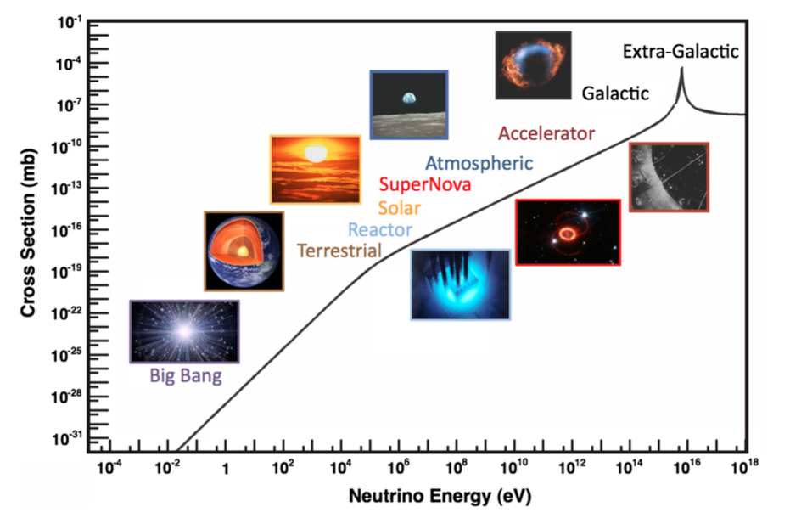
Where are neutrinos produced?
Formaggio & Zeller, Rev Mod Phys 84, 1307 (2012)
Notes:
CMB: 412 photons per cubic cm
CNB: 336 neutrinos per cubic cm

Slide 3
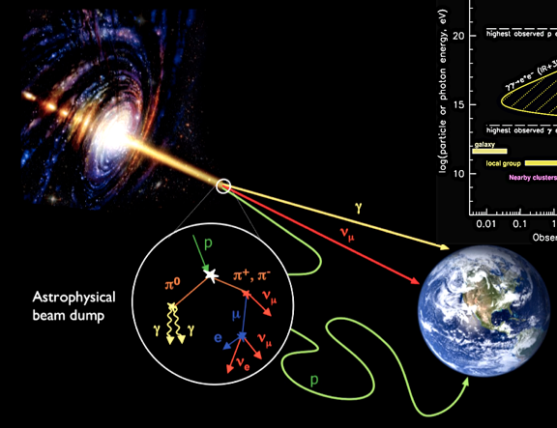
Multi-messenger astrophysics with
cosmic rays
gamma rays
neutrinos
gravitational waves
Opening many science topics including:
where and how are cosmic rays produced?
Neutrinos indicate a hadronic (or exotic) source
Notes:
At 1 TeV cross section is ~10^-12 mb (Formaggio)

Slide 4
Gamma rays, neutrinos, and cosmic rays
all have ~equal energy density
IceCube, PRD 104, 022002 (2021)
Implies there is likely a deep connection among them
Despite this, sky looks very different in each messenger
Notes:
From https://arxiv.org/format/2011.03545
FIG. 1. High-energy fluxes of gamma rays, neutrinos, and cosmic rays. The segmented power-law neutrino flux, described in Sec. VI A 5, obtained in the analysis described in this paper, is shown with red circles. The single power-law assumption, described in Sec. VI A 1, is shown with the light red region. The high-energy gamma-ray measurements by Fermi [17] are shown in orange, while the extremely-high-energy cosmic-ray measurements by the Pierre Auger Observatory [18] are shown as purple data points. The comparable energy content of these three fluxes is of particular interest in the investigation of cosmic-ray origin.

Slide 5
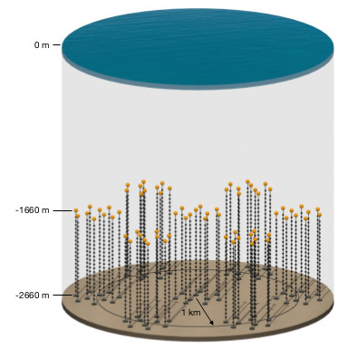
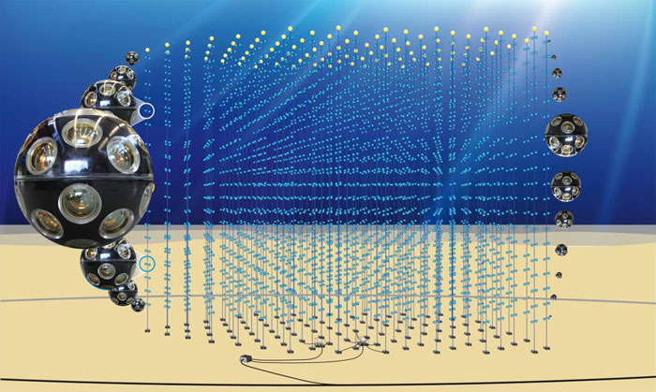
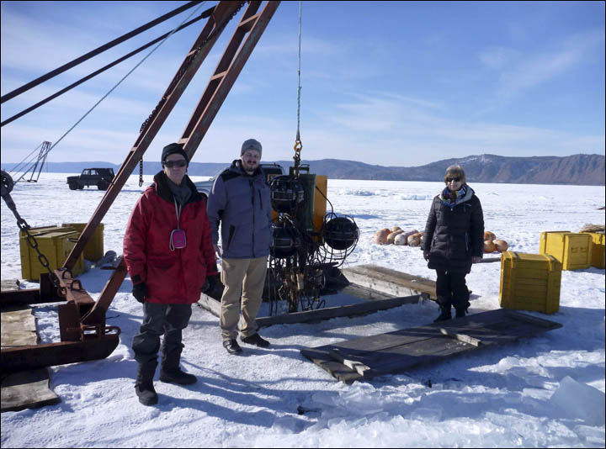
Neutrino telescopes around the world
(using optical Cherenkov technique)
ANTARES
(0.01 km³)
KM3Net
(1.1 km³)
STRAW
P-ONE
IceCube
(1 km³)
Upgrade
Gen 2
(7.9 km³)
Baikal GVD
(1 km³)
running under construction proposed/planned
Notes:
Gen2 7.9 km³:
https://iopscience.iop.org/article/10.1088/1361-6471/abbd48

Slide 6
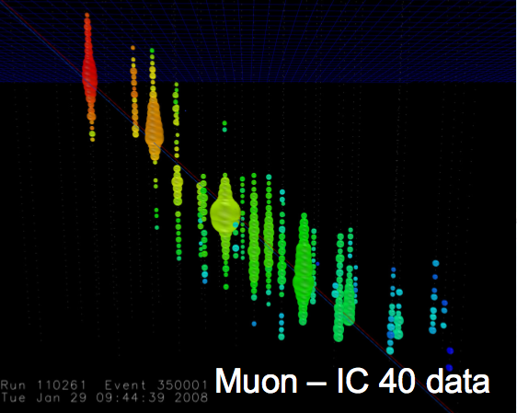
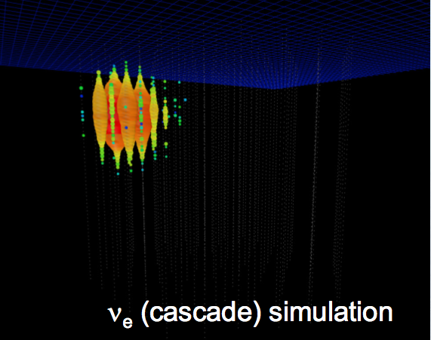
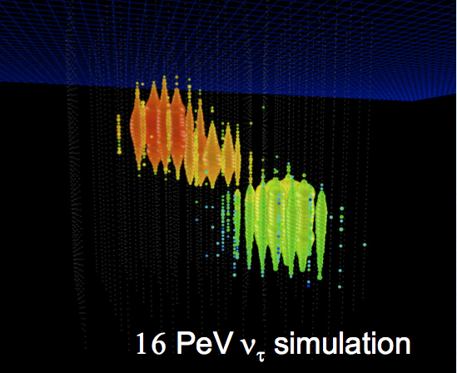
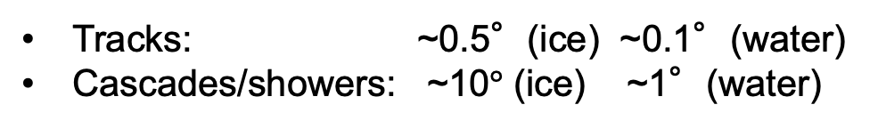
Interaction channels and flavor identification
Muon (experimental data)
Muon neutrino
+ Straight track,
points to neutrino source,
angular resolution ~1°
- Cosmic-ray muon background
Electron neutrino
+ Good energy resolution
- Cascade, ideally in detector
- Poor angular resolution
Tau neutrino
+ Double bang signature,
low background
+ Pointing capability
- Low rate
Tracks: ~0.5°(ice) ~0.1°(water)
Cascades/showers: ~10$°$ (ice) ~1°(water)
Notes:
Tau decay length vs. energy
Muon is IC 40 data
Cascade is simulation
Nu tau is simulation

Slide 7
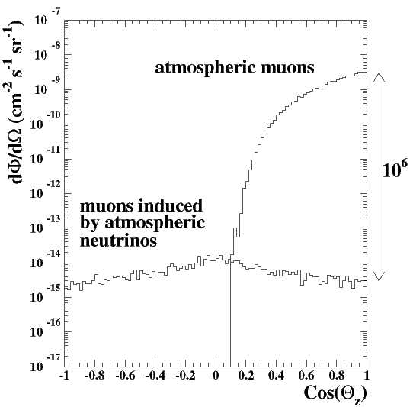
Signals and backgrounds in neutrino telescopes
Most events detected by neutrino telescopes are not astrophysical neutrinos
atmospheric μ ~70 billion / year / km³
atmospheric ν_{μ} → μ ~80 thousand / year / km³
astrophysical ν_{μ} → μ ~10 / year / km³ (above 200 TeV)
Background and signal differ in spectrum and angular distribution
energy distribution
angular distribution
conventional
atmospheric
atmospheric muons
astrophysical
atmospheric neutrinos
prompt atmospheric
cosmogenic
up-going
down-going
Notes:
Francis: 550 cosmic neutrinos in the Aachen analysis on a background of 340,000
Waxman-Bahcall is scaled by 3/2 (why?)
Atmospheric neutrino production:
Cosmic rays produce muons, pions, kaons which decay to neutrinos
Toward horizon, more atmosphere column depth within which particles can decay before being absorbed by Earth
Prompt/charm: don’t need path length to decay
80e3/70e9= 1e-6

Slide 8
Complementary sky coverage of IceCube and ANTARES/KM3NeT
IceCube,
ApJ 857 (2018) 117
South
North
Notes:
Figure 9. Left panel: the effective area of IceCube to muon neutrinos with energies 100 GeV–10 PeV is shown for the event selection applied to this analysis’ data samples. For comparison, the effective area of the ANTARES observatory’s point-source event selection is shown over the same range (circles). Below 1 TeV, the effective area of ANTARES is greater for most of the southern sky and that of IceCube dominates in the north. Above 50 TeV, IceCube’s effective area dominates in all decl. in the energy range for which data are available. Right panel: a 2D plot shows the ratio of the effective areas of IceCube to ANTARES over energy and decl., with a bin-width of 0.1 in sin(δ) and bin-height equal to one-quarter of a decade in energy. Where ANTARES provides a non-zero effective area but IceCube’s is equal to zero for this event selection, the ratio plotted is the scale minimum 10−2 ; likewise, where the converse is true, the ratio plotted is the scale maximum 103 .

Slide 9
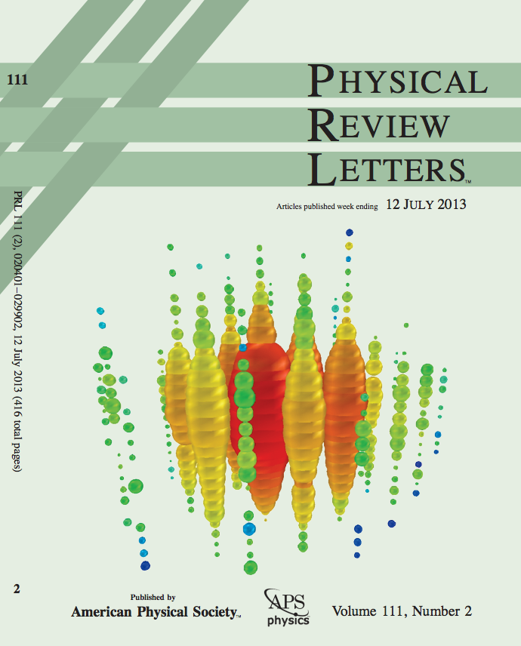
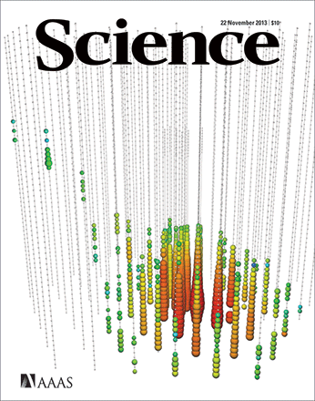
Discovery of a diffuse astrophysical neutrino flux
(“high-energy starting events”)
Two PeV events in two years (2.8 σ)
28 additional events in two years (4.1 σ)
IceCube, PRL 111, 021103 (2013) IceCube, Science 342, 1242856 (2013)
IceCube, PRL 113, 101101 (2014) IceCube, PRD 104, 022002 (2021)
Notes:
FIG.4 (color online). The two observed events from (a) August 2011 and (b) January 2012. Each sphere represents a DOM. Colors represent the arrival times of the photons where red indicates early and blue late times. The size of the spheres is a measure for the recorded number of photoelectrons.
http://antarcticaneutrinos.blogspot.com/2013/04/bert-and-ernie-step-out.html
Bert (left), Ernie (right)

Slide 10
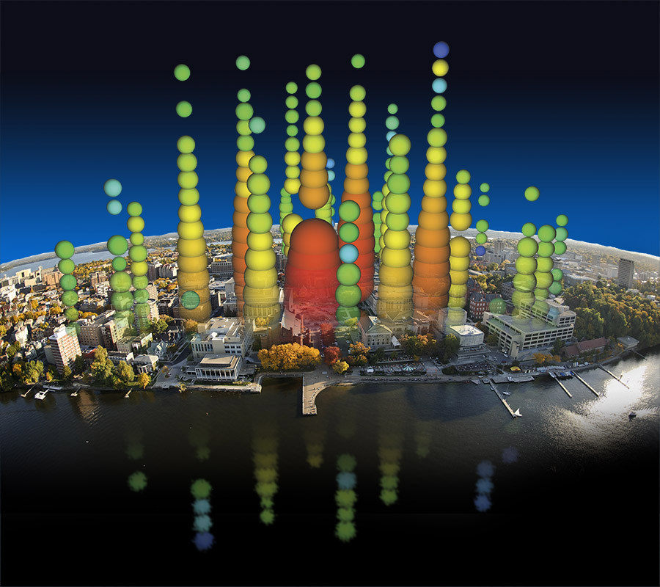
Notes:
Bert over Lake Mendota / Memorial Union Terrace

Slide 11
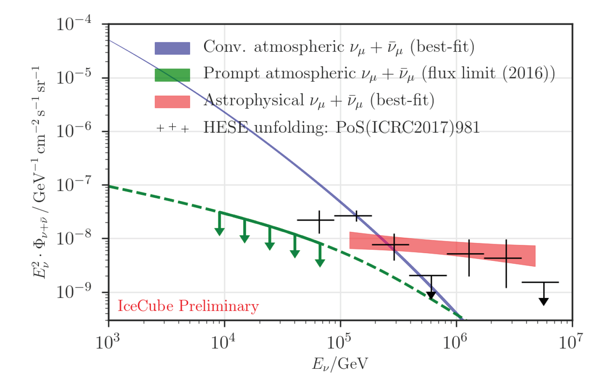
Through-going Northern tracks (8 years)
6.7 𝜎 significance
IceCube, ApJ 833:3 (2016)
IceCube, 1908.09551 (ICRC)
Astrophysical neutrinos
measured with two interaction and detection methods
Notes:
8 years of data
(Published ApJ is 6 years)
Significance: 5.6, 6.7 sigma respectively
IceCube, 1710.01191 (ICRC)
IceCube, 1908.09551 (ICRC)

Slide 12
What is producing the neutrinos?
Which ideas do you have?
Notes:
Audience ideas:
AGN
Jets
Starburst galaxies
Tidal disruption events

Slide 13
What is producing the neutrinos? constraining candidate sources and source classes
Gamma-ray bursts
Star-forming galaxies
Active galactic nuclei inc. blazars (time averaged)
Active galactic nuclei inc. blazars (flares)
Galaxy clusters
Supernovae
Galactic diffuse emission
Discrete Galactic sources
Binary black hole or neutron star mergers
Novae
Tidal disruption events
Fast radio bursts
Dark matter

Slide 14
All-sky search for discrete neutrino sources (neutrino clusters)
IceCube, PRL 124, 051103 (2020)
10-year dataset
The neutrino flux is ~isotropic
Comparing the measured diffuse flux with point source upper limits: there are at least ~10² sources
Notes:
FIG. 6: Skymap of -log10(plocal), where plocal is the local pre-trial p-value, for the sky between ±82◦ declination in equatorial coordinates. The Northern and Southern hemisphere hotspots, defined as the most significant plocal in that hemisphere, are indicated with black circles.
At least 10^2 sources:

Slide 15
All-sky search for discrete neutrino sources (neutrino clusters)
IceCube, PRL 124, 051103 (2020)
NGC 1068
Analysis (1) all-sky (4π) search
Analysis (2) source list search: 110 gamma-selected objects
Most significant candidate source coincides with most significant all-sky search: NGC 1068 / M 77 (a Seyfert II galaxy)
Notes:
Caveat: *Northern*
0.35° offset
Southern catalog: p=0.059 for PKS 2233-148 (0.55 post-trials)
Seyferts based on optical
I vs. II: emission lines
Seyfert I: broad allowed lines and narrow forbidden lines, all broader than in normal galaxies; observe central source directly
Seyfert II: only narrow lines, both allowed and forbidden (electron transitions that can occur spontaneously but forbidden / improbable stimulated according to QM selection rules); AGN are obscured; only colder outer regions are seen
Figure from source at https://arxiv.org/abs/1908.05993

Slide 16
All-sky search for discrete neutrino sources (neutrino clusters)
IceCube, PRL 124, 051103 (2020)
see also ANTARES, ApJ 911:48 (2021)
Population analysis (search for excess of weak sources): 3.3 𝜎 post-trials, for combination of 4 sources each with p<0.01 in source list search: NGC 1068 and 3 blazars (TXS 0506+056, PKS 1424+240, GB6 J1542+6129)
Excluding TXS 0506+056: 2.3 𝜎 post-trials; NGC 1068 alone: 2.9 𝜎 post-trials (4.1 𝜎 pre-trials)
Notes:
Southern population analysis: p=0.36 post-trials, for 5 of the 13 tested sources
Figure from source at https://arxiv.org/abs/1908.05993
TXS alone: 3.6 sigma pre-trials

Slide 17
Gamma-ray bursts contribute negligibly to total neutrino flux
ANTARES
IceCube
IceCube,
ApJ 843:112 (2017)
excluded region
allowed
ANTARES, MNRAS 469, 906-915 (2017)
ANTARES, MNRAS 500, 5614-5628 (2021)
IceCube, ApJ 843 112 (2017)
Notes:
Figure 9. GRB ANTARES quasi-diffuse flux for 784 GRBs, in equation (4), (red solid line) and the corresponding 90 per cent CL upper limit (dashed red line). The red shaded regions show the uncertainty around the GRB quasi- diffuse flux, as in Fig. 5, and also around the computed upper limit, derived as explained in Section 8. IceCube best fits for νμ tracks in 10 yr (Stettner et al. 2019) and for HESE events in 7.5 yr of collected data (Schneider et al. 2019) are shown in blue and green, respectively.
Figure 8. Excluded regions for a given CL of the generic double broken power law neutrino spectrum as a function of first break energy εb and per-flavor quasi-diffuse flux normalization Φ0 derived from the presented results combined with previous Northern Hemisphere track (Aartsen et al. 2015d) and all-sky cascade (Aartsen et al. 2016a) searches. Models of neutrino production assuming GRBs are the sole source of the measured UHECR flux either by neutron escape (Ahlers et al. 2011) or proton escape (Waxman & Bahcall 1997) from the relativistic fireball are provided for reference.
Implications for GRB as CR sources?
1172 satellite-detected GRBs
No GRB correlation with five years of muon neutrino track events
Conclusion: <1% of astrophysical neutrino flux is produced by GRBs
Non-detection also disfavors GRBs as primary source of UHE cosmic rays

Slide 18
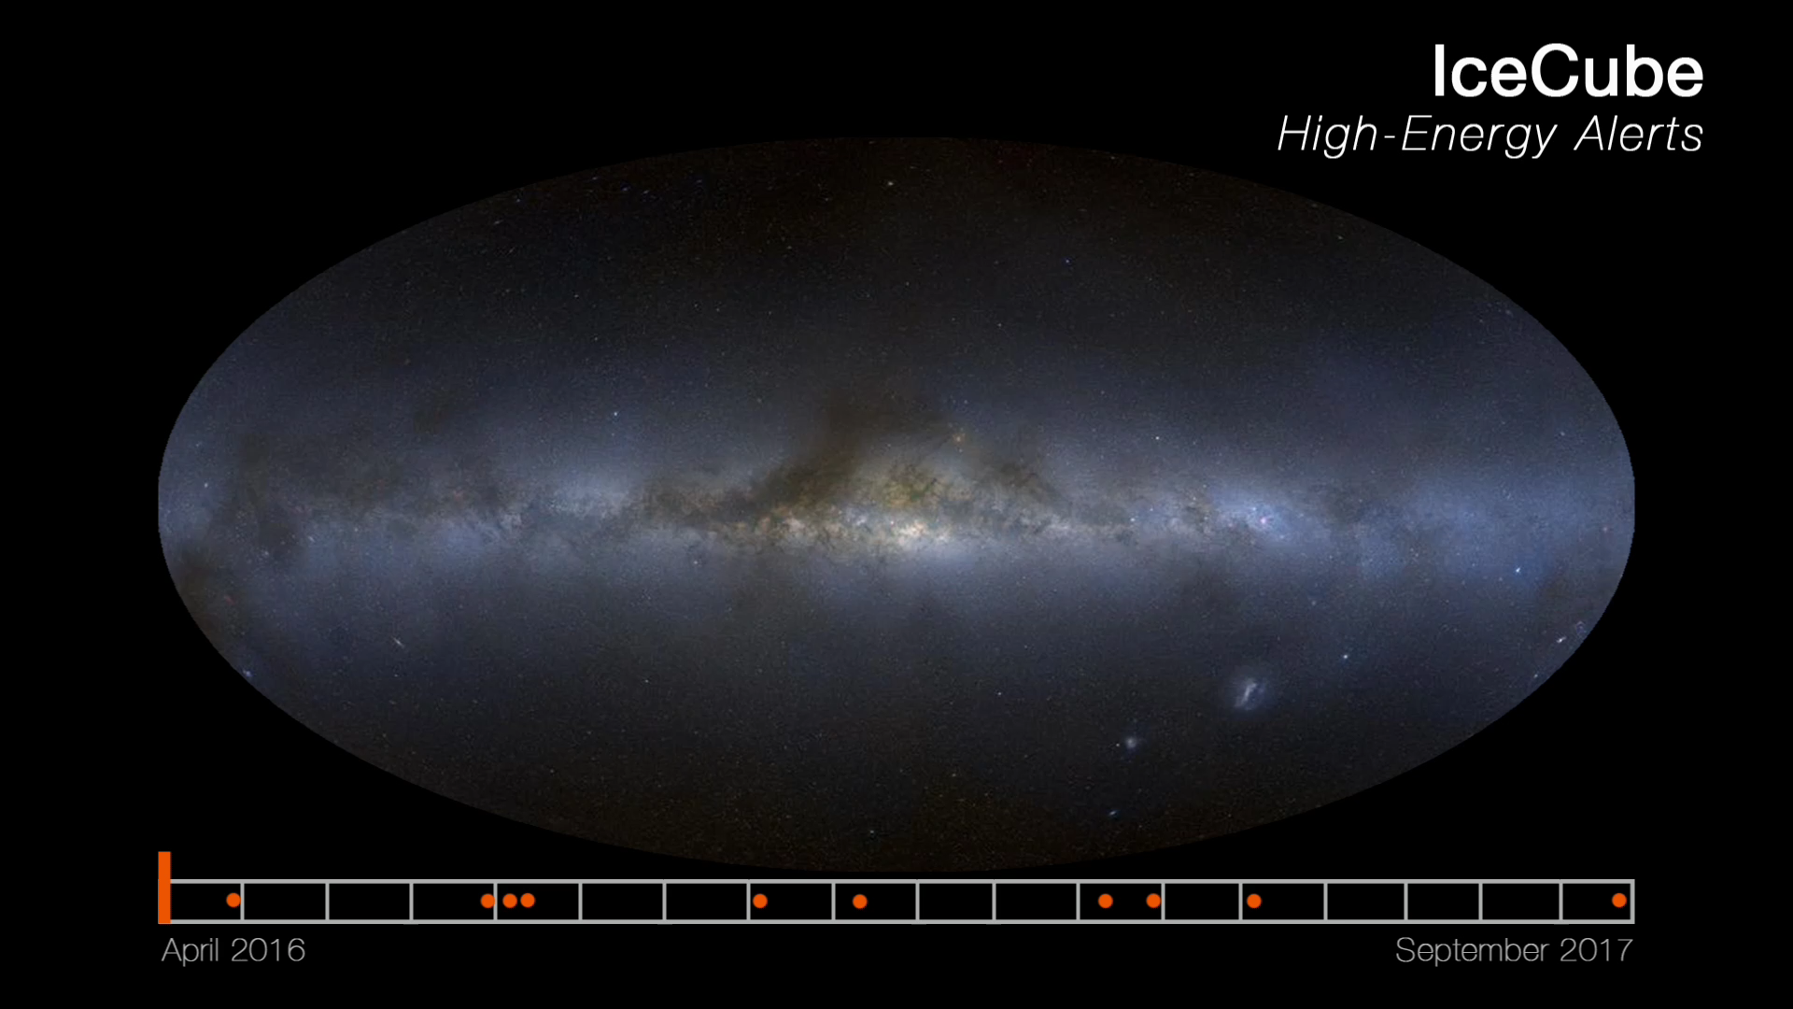
The first 10 IceCube real-time, public alerts
20-30 alerts per year since 2016, with <1 minute latency
Notes:
What is rate per year today?

Slide 19
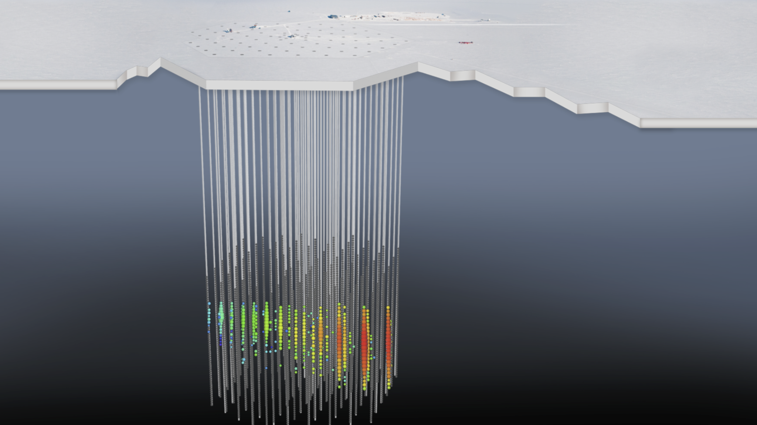
IceCube-170922A
A track with angular uncertainty ~1°
Declination +5.7°, neutrino energy ~290 TeV
Announced in public alert (GCN) 43 seconds after interaction
Notes:
Enu > 183 TeV at 90% CL
Deposited energy 24 TeV

Slide 20
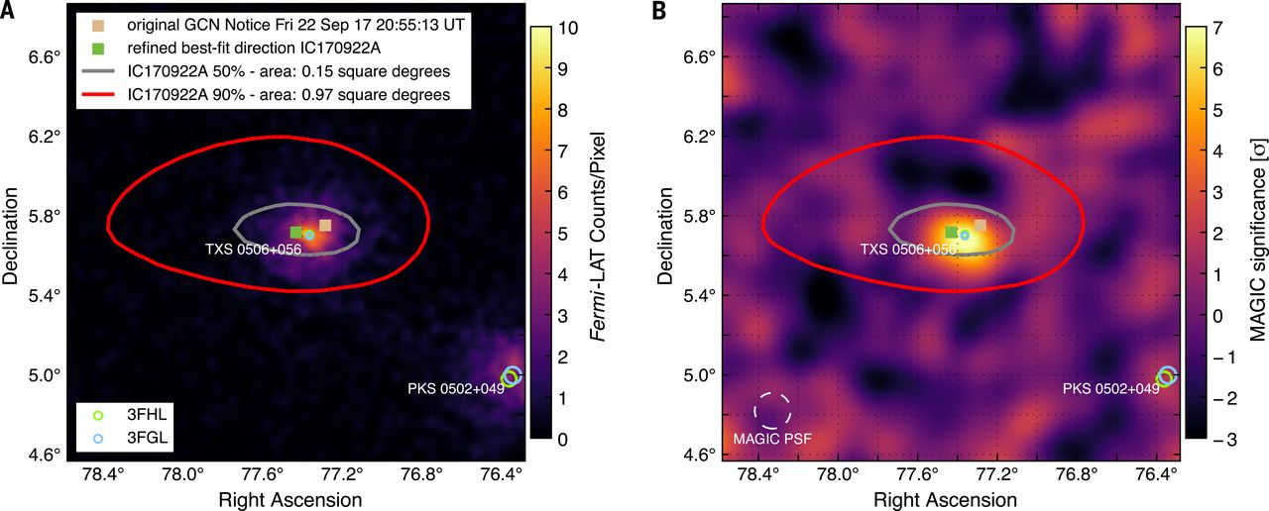
A flaring GeV gamma-ray blazar in the same direction as the neutrino
0.1°separation between blazar and best-fit neutrino direction
MAGIC detected blazar for first time in VHE band

Slide 21
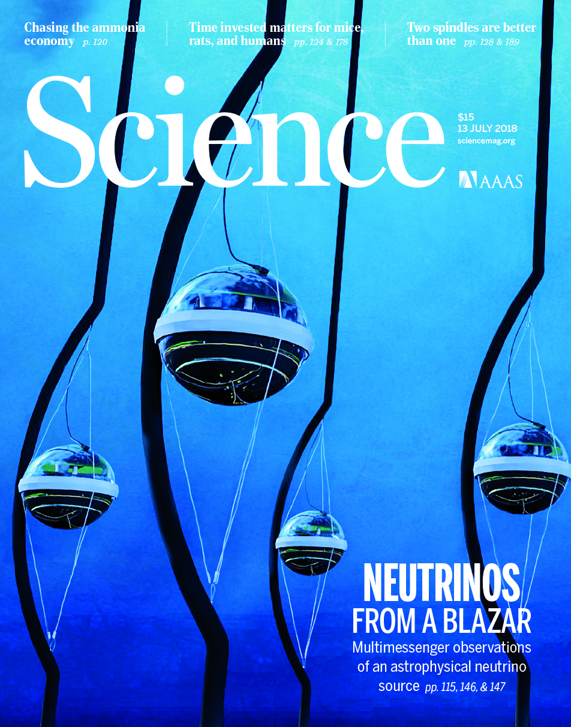
Neutrinos from blazar TXS 0506+056: two neutrino flares (one gamma-bright and one gamma-dim)?
“Multimessenger observations of a flaring blazar coincident with high-energy neutrino IceCube-170922A”
  ~3 𝜎 neutrino-gamma coincidence
“Neutrino emission from the direction of the blazar TXS 0506+056 prior to the IceCube-170922A alert”
  First 7 years (excluding 170922A): 2.1 𝜎
  Neutrino flare in late 2014 – early 2015: 3.5 𝜎
Notes:
Paper 1 coincidence significance: 3.0 sigma

Slide 22
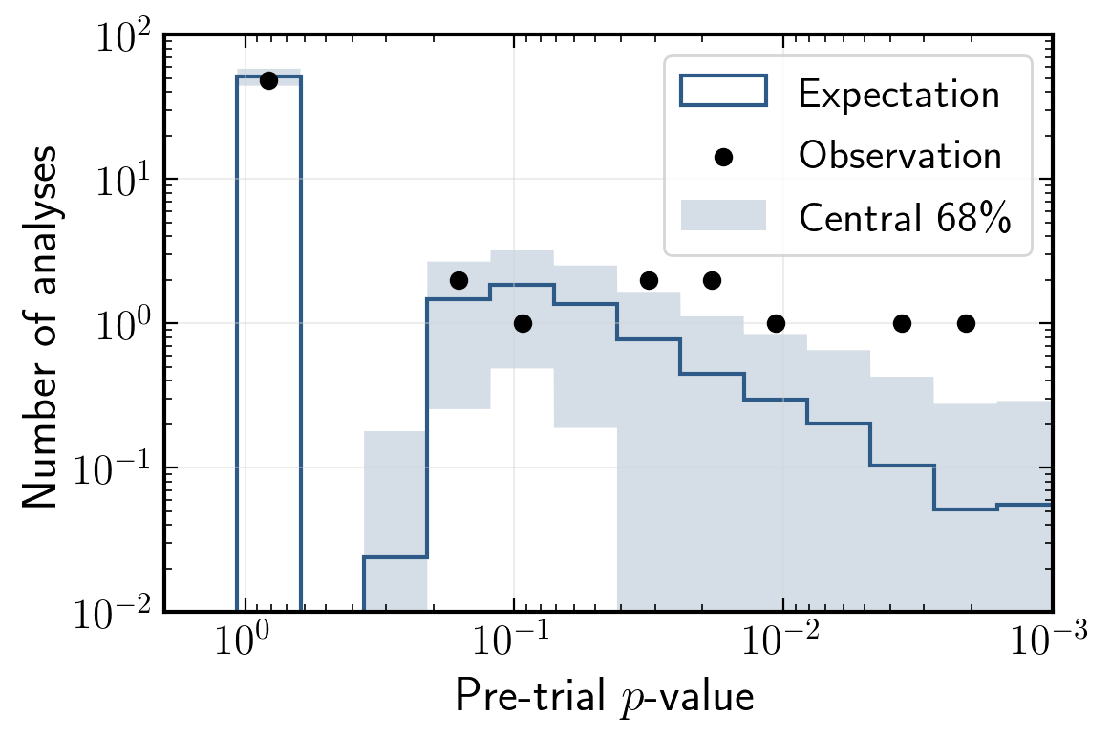
Opposite of neutrino alerts: fast neutrino analysis triggered by other observatories
58 analyses as of July 2020
IceCube, ApJ 910:4 (2021)
Rapid search for 𝜈 counterparts of transients reported by other observatories
Neutrino telescopes record all directions all times: excellent for transient follow-up
Notes:
Figure 9. Skymaps for the two analyses which resulted in a p-value less than 0.01, pre-trials. Maps are centered on the location of the source being investigated. Each colored × represents a neutrino candidate event in the GFU sample, the color represents the arrival time of the event, and the size of the circle is each event’s angular uncertainty (90% containment). The analysis for PKS 0346-27 (left) lasted four days containing a period of increased gamma-ray emission detected by Fermi-LAT and the analysis of a newly detected gamma-ray source Fermi J1153-1124 (right) was 2 days in duration.
Figure 5. Distribution of p-values from all analyses. The p-values represent the outcome of each individual analysis, and do not include a trials correction for the ensemble of all analyses performed. As many of these analyses are looking for coincidences over short time windows, a large fraction of analyses have zero coincident events, yielding T = 0, and a pvalue of exactly 1.0. We compare our distribution of p-values to those expected from many sets of ensembles of pseudoexperiments from scrambled background data for each of the 58 analyses performed.
58
Log10(p) = -2.40, -2.57
->
p = 0.40%, 0.27%
Reading off plot:
p = 2e-3 and 3e-3
->
Log10(p) = -2.70, -2.52
10^(-2e-3) = -2.70, log10(3e-3) = -2.52
Most significant

Slide 23
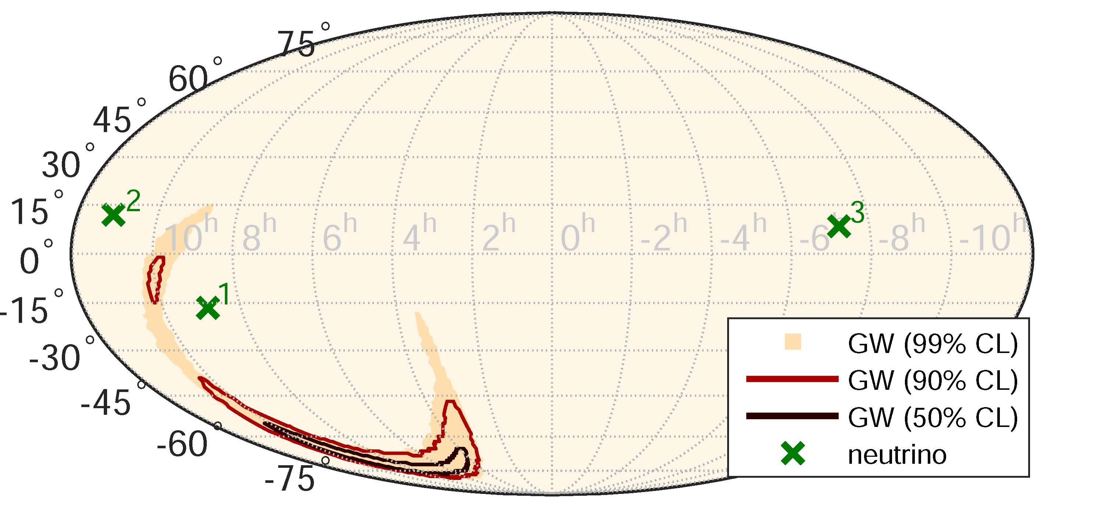
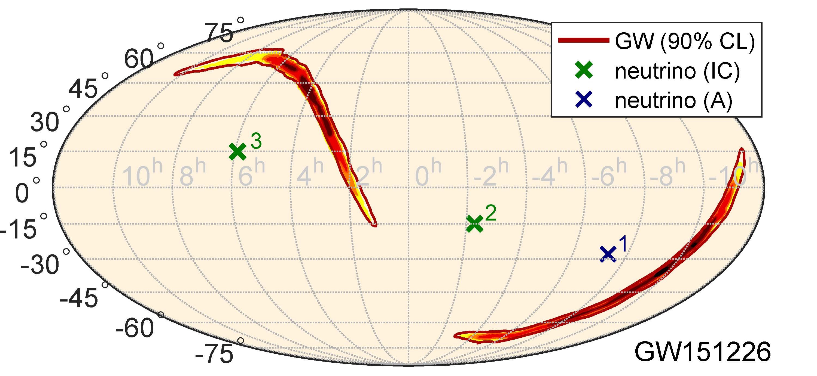
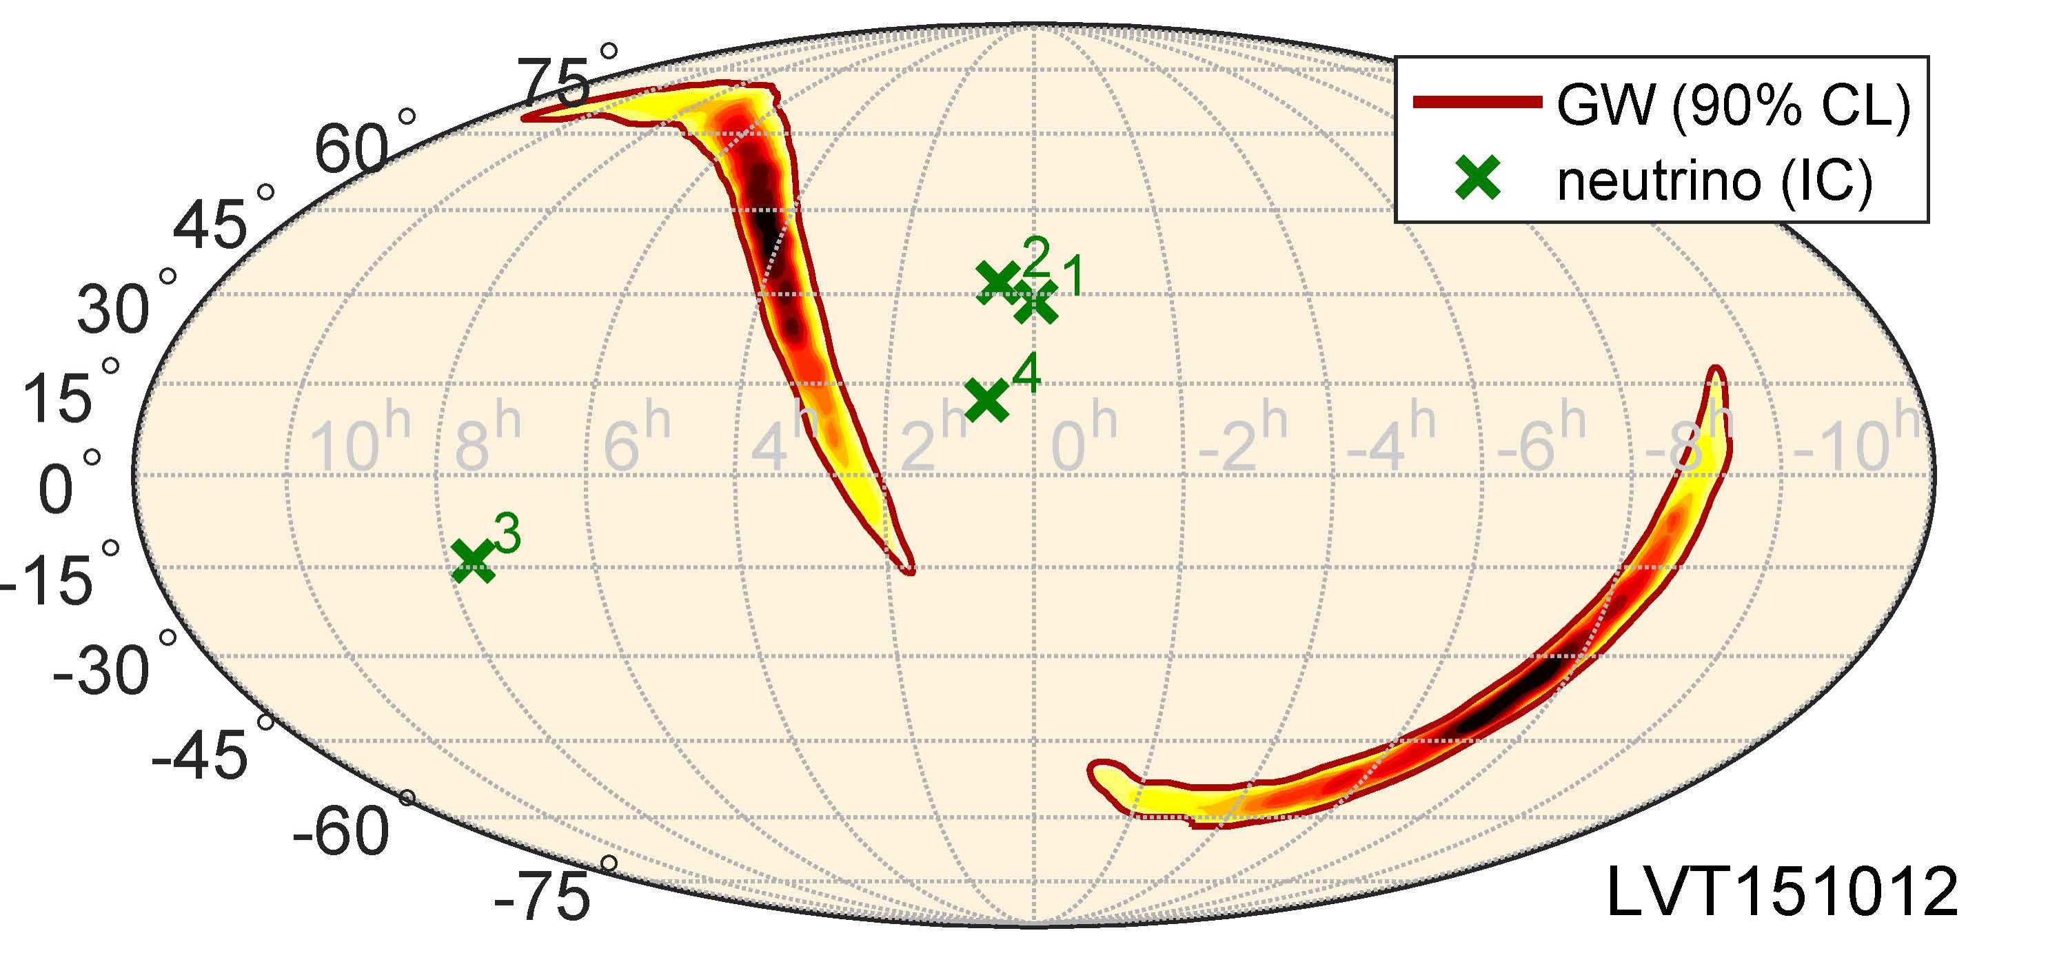
Neutrinos coincident with gravitational waves?
Binary black hole (GW150914)
Binary neutron star (GW 170817)
PRD 93, 122010 (2016)
ApJL 850:L35 (2017)
PRD 96, 022005 (2017)
(IceCube, ANTARES, Auger, LIGO/VIRGO)
See also GVD, JETP Lett. 108 (2018) no.12, 787-790
Notes:
Figure 1. Localizations and sensitive sky areas at the time of the GW event in equatorial coordinates: GW 90% credible-level localization (red contour; Abbott et al. 2017b), direction of NGC 4993 (black plus symbol; Coulter et al. 2017b), directions of IceCube’s and ANTARESʼs neutrino candidates within 500 s of the merger (green crosses and blue diamonds, respectively), ANTARESʼs horizon separating down-going (north of horizon) and up-going (south of horizon) neutrino directions (dashed blue line), and Auger’s fields of view for Earth-skimming (darker blue) and down-going (lighter blue) directions. IceCube’s up-going and down-going directions are on the northern and southern hemispheres, respectively. The zenith angle of the source at the detection time of the merger was 73.°8 for ANTARES, 66°.6 for IceCube, and 91°.9 for Auger.
150914: 3 neutrinos
Neutrino search: ±500 seconds
GW150914: 3 IceCube, 0 ANTARES, muon energies 0.33-175 TeV
GW151226: 2 IceCube, 1 ANTARES, muon energies 6.3-158 TeV
LVT151012: 4 IceCube, 0 ANTARES, muon energies 0.35-13.7 TeV
Top 1 panel:
FIG. 1. GW skymap in equatorial coordinates, showing the reconstructed probability density contours of the GW event at 50%, 90% and 99% CL, and the reconstructed directions of high- energy neutrino candidates detected by IceCube (crosses) during a `500 s time window around the GW event. The neutrino directional uncertainties are < 1° and are not shown. GW shading indicates the reconstructed probability density of the GW event, darker regions corresponding to higher probability. Neutrino numbers refer to the first column of Table I.
Bottom 2 panels:
FIG. 1. GW skymap for GW151226 (top) and LVT151012 (bottom), and the reconstructed directions for high-energy neutrino candidates detected by IceCube (green crosses) and Antares (blue cross) within ±500 s around the GW signals. The maps are in equatorial coordinates. The GW skymap shows the reconstructed probability density contours of the GW event 90% CL. GW shading indicates the reconstructed probability density of the GW event, darker regions corresponding to higher probability. The neutrino directional un- certainties are below 1◦ for most of the candidates, and in any case too small to be shown. Neutrino event numbers refer to the first column of Table I.

Slide 24
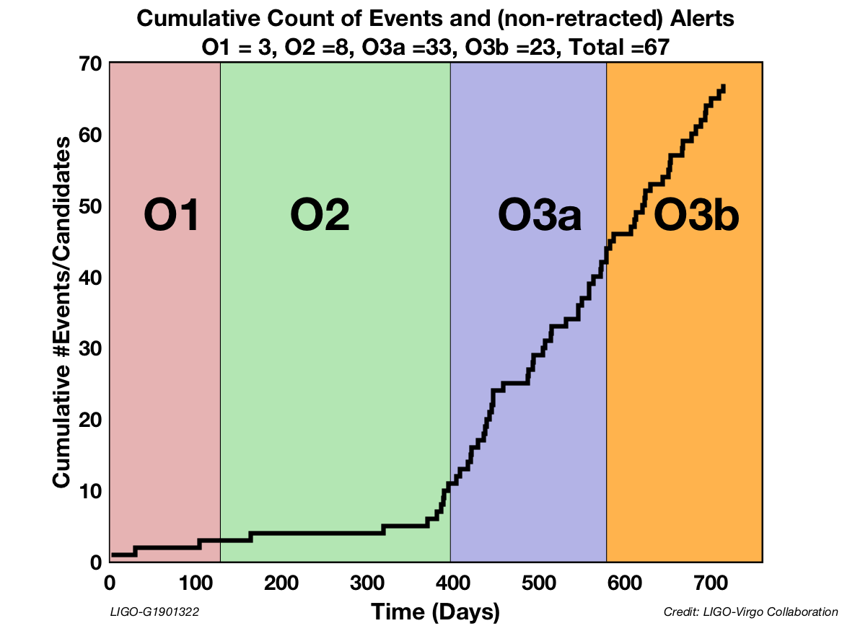
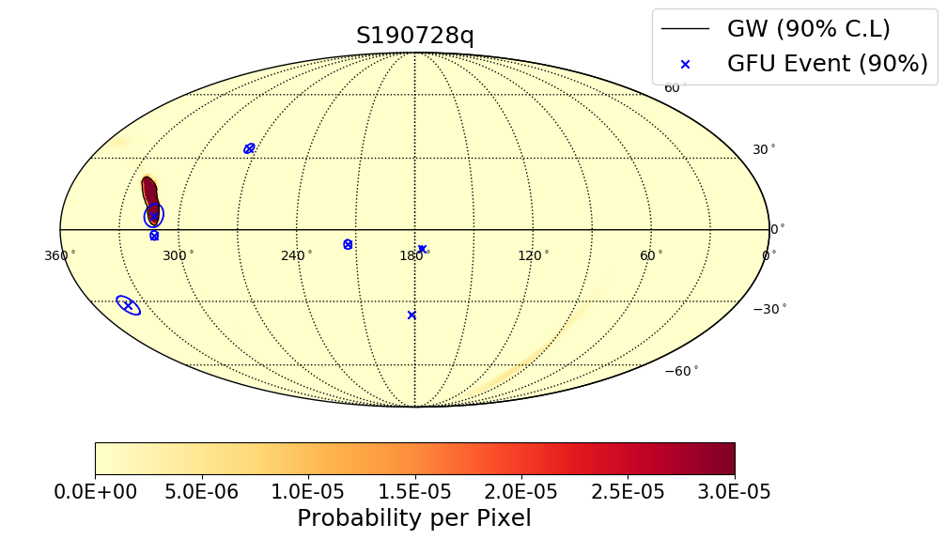
Real-time search for neutrinos from gravitational wave sources during LIGO/Virgo observing run O3
Example GW-coincident IceCube event reported publicly within few hours of GW
p=0.0136
(pre-trial)
56 open public alerts (OPA) in O3 (April 2019 through March 2020)
67 total events/candidates in O1, O2, and (open public alerts of) O3
47 BBH, 7 BNS, 5 NSBH, 4 Mass gap, 3 terrestrial, 1 coherent wave burst
Note: GWTC-2 and GWTC-2.1 provide revised GW candidates compared to OPA
IceCube, arXiv:1908.07706 (ICRC 2019)
IceCube, arXiv:2107.09663 (ICRC 2021)
Notes:
S190405ar was retracted
S190421ar: 3% Terrestrial (1e-8 Hz FAR)
S190426c: 24% MassGap, 14% terrestrial, 13% NSBH
S190510g: 42% BNS
S190513bm: 5% MassGap
S190517h: 2% MassGap
S190518bb: 25% Terrestrial (1e-8 Hz FAR)
S190518bb was retracted (28±15 Mpc BNS 75%)
S190519bj: 4% Terrestrial
S190521g 3% Terrestrial
1e-8 Hz * 3e7 sec = 0.3 false alarms per year = 1 false alarm every 3-4 months
2 total retractions
Using distances from LAL Inference when available, otherwise bayestar
As of May 21:
51 days / 13 GW = one every 4 days
13/51 days

Slide 25
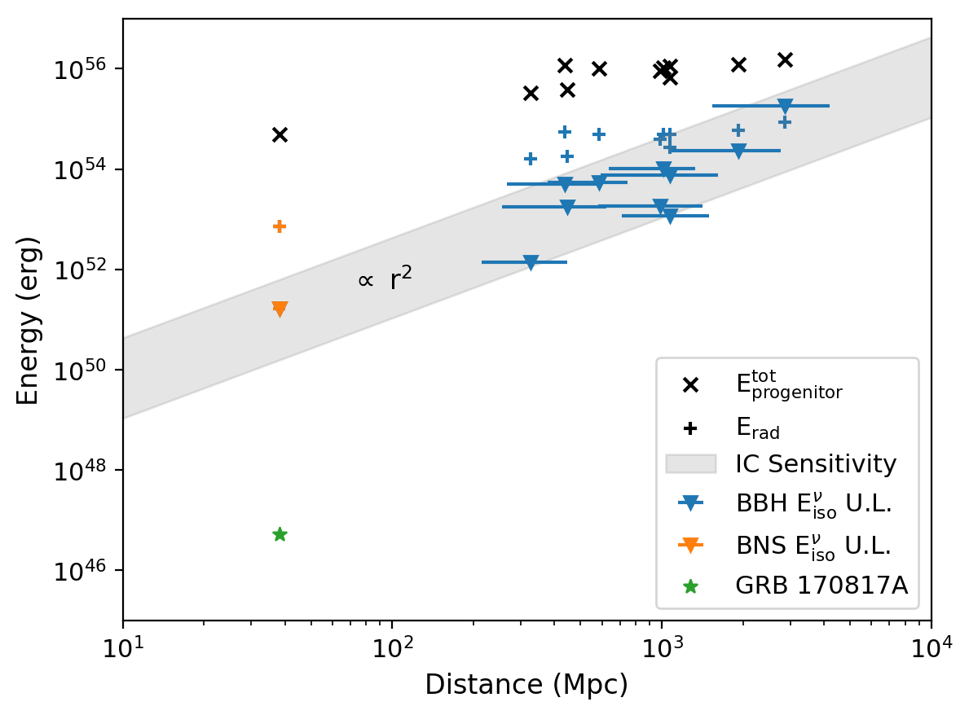
Comparison of energy radiated in neutrinos (upper limits) vs. gravitational waves and gamma rays (measured)
IceCube,
ApJ Letters 898 (2020) L10
All 11 gravitational waves from LIGO/Virgo O1 and O2 (10 BBH & 1 BNS)
Notes:
Abstract
Using the IceCube Neutrino Observatory, we search for high-energy neutrino emission coincident with compact binary mergers observed by the LIGO and Virgo gravitational-wave (GW) detectors during their first and second observing runs. We present results from two searches targeting emission coincident with the sky localization of each GW event within a 1000 s time window centered around the reported merger time. One search uses a model-independent unbinned maximum-likelihood analysis, which uses neutrino data from IceCube to search for pointlike neutrino sources consistent with the sky localization of GW events. The other uses the Low-Latency Algorithm for Multi-messenger Astrophysics, which incorporates astrophysical priors through a Bayesian framework and includes LIGO-Virgo detector characteristics to determine the association between the GW source and the neutrinos. No significant neutrino coincidence is seen by either search during the first two observing runs of the LIGO-Virgo detectors. We set upper limits on the time-integrated neutrino emission within the 1000 s window for each of the 11 GW events. These limits range from 0.02 to 0.7 . We also set limits on the total isotropic equivalent energy, E _{iso}, emitted in high-energy neutrinos by each GW event. These limits range from 1.7 × 10⁵¹ to 1.8 × 10⁵⁵ erg. We conclude with an outlook for LIGO-Virgo observing run O3, during which both analyses are running in real time.
S190405ar was retracted
S190421ar: 3% Terrestrial (1e-8 Hz FAR)
S190426c: 24% MassGap, 14% terrestrial, 13% NSBH
S190510g: 42% BNS
S190513bm: 5% MassGap
S190517h: 2% MassGap
S190518bb: 25% Terrestrial (1e-8 Hz FAR)
S190518bb was retracted (28±15 Mpc BNS 75%)
S190519bj: 4% Terrestrial
S190521g 3% Terrestrial
1e-8 Hz * 3e7 sec = 0.3 false alarms per year = 1 false alarm every 3-4 months
2 total retractions
Using distances from LAL Inference when available, otherwise bayestar
As of May 21:
51 days / 13 GW = one every 4 days
13/51 days

Slide 26
Neutrinos from fast radio bursts?
First 4 FRBs: S. Fahey et al., ApJ 845 (2017) 1, 14
6-year TeV search: IceCube, ApJ 857 (2018) 117
8-year MeV and low-threshold TeV search: IceCube, ApJ 890:111 (2020)
Notes:
Figure 8. Sensitivity vs. ΔT for two emission spectra, E−2 and E−3 , in each hemisphere for source list sizes ranging from 10 to 100,000 FRBs, is shown. The stacking sensitivity of FRBs relies on the number and locations of sources detected. Because the list of detected FRBs is expected to grow exponentially in the coming years and without significant directional bias, the per-burst sensitivity to an isotropic hemisphere of FRBs has been calculated for a range of source list sizes. The respective stacking sensitivities from this analysis are overlaid for comparison, with total fluence divided by the number of sources—9 in the south, 20 in the north—for per-burst fluence. These sensitivities outperform the expected sensitivity to an isotropic sky because the FRBs in this analysis were of higher-than-isotropic decl. on average. As our background rates peak at the horizon, the rate of coincident background events in stacking trials was lower than what would be expected from an isotropic distribution of FRBs as well. This lowers the baseline for the stacking sensitivity curve and moves the up-turn at large ΔT to the right, as shown by the crossover near 104 s in each plot. For comparison, the limits set by constraining the total all-sky FRB fluence to be less than or equal to IceCube’s astrophysical νμ flux are provided, assuming an FRB occurrence rate of 3000 sky−1 day−1 . With data optimized specifically for sensitivity to FRBs and an orders-of-magnitude larger FRB source list, we expect future limits to improve upon those set by IceCube’s diffuse astrophysical neutrino flux.

Slide 27
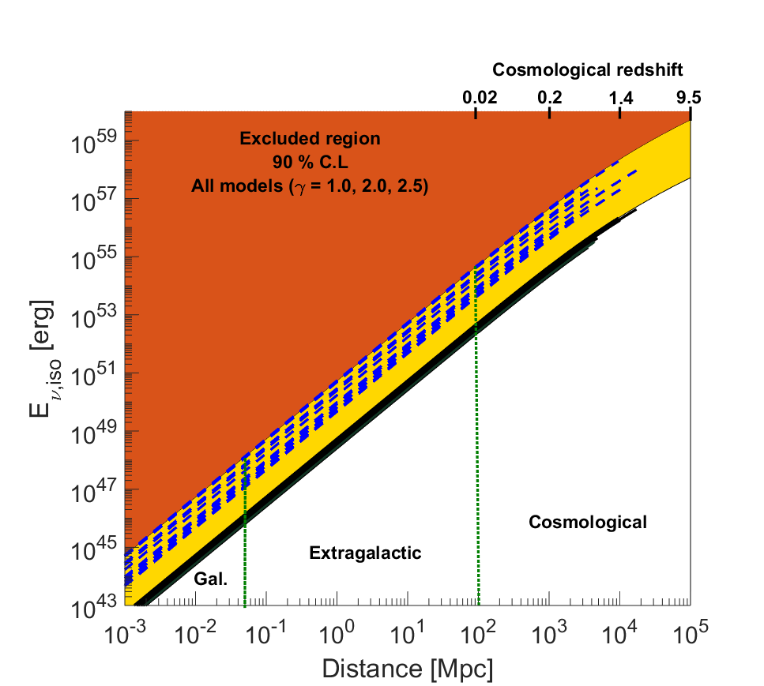
ANTARES fast radio burst analysis
ANTARES, MNRAS 482, 184–193 (2019)
Notes:
Figure 2. The 90 per cent confidence level ANTARES upper limits on the neutrino fluence for the power-law spectral models with γ = 1.0 (blue), 2.0 (red) and 2.5 (black), for each FRB. The limits are computed in the energy range [Emin; Emax] where 5–95 per cent of the neutrino signal is expected.
Figure 3. The 90 per cent confidence level upper limits on the neutrino energy released by the fast radio burst sources. The per-burst limits, assuming different neutrino power-law spectra, are shown with the dashed blue lines (γ = 1.0) and the black solid lines (γ = 2.5). These limits are computed in the distance range d ∈ [1 kpc ; D(zDM)]. The red area indicates the region that is already excluded by ANTARES at the 90 per cent confidence level for any considered hadronic model (γ = 1.0, 2.0, 2.5). The yellow area is only excluded by the soft spectral models (γ = 2.0, 2.5). The white area, divided into three distance scenarios, is still allowed according to the ANTARES sensitivity.

Slide 28
ANTARES X-ray binary flare analysis
(transition state)
ANTARES, JCAP04 (2017) 019
Notes:
Abstract
ANTARES is currently the largest neutrino telescope operating in the Northern Hemisphere, aiming at the detection of high-energy neutrinos from astrophysical sources. Neutrino telescopes constantly monitor at least one complete hemisphere of the sky, and are thus well-suited to detect neutrinos produced in transient astrophysical sources. A time-dependent search has been applied to a list of 33 X-ray binaries undergoing high flaring activities in satellite data (RXTE/ASM, MAXI and Swift/BAT) and during hardness transition states in the 2008–2012 period. The background originating from interactions of charged cosmic rays in the Earth's atmosphere is drastically reduced by requiring a directional and temporal coincidence with astrophysical phenomena. The results of this search are presented together with comparisons between the neutrino flux upper limits and the neutrino flux predictions from astrophysical models. The neutrino flux upper limits resulting from this search limit the jet parameter space for some astrophysical models.
Figure 3. Upper limits at 90% C.L. on the neutrino fluence for the 33 XRB with outburst periods (left) and for the 8 XRB with transition state periods (right) in the case of E−2 (green triangles), E−2 exp(−E/100 TeV) (red triangles) and E−2 exp(−E/10 TeV) (blue triangles) neutrino energy spectra.

Slide 29
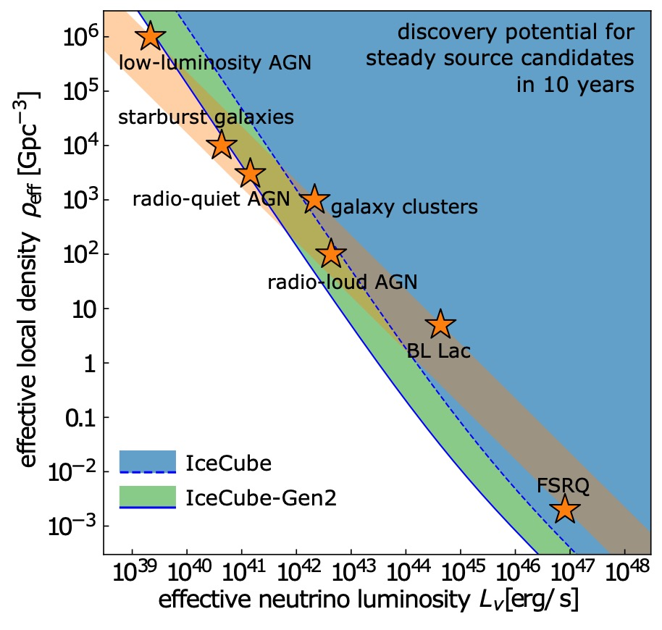
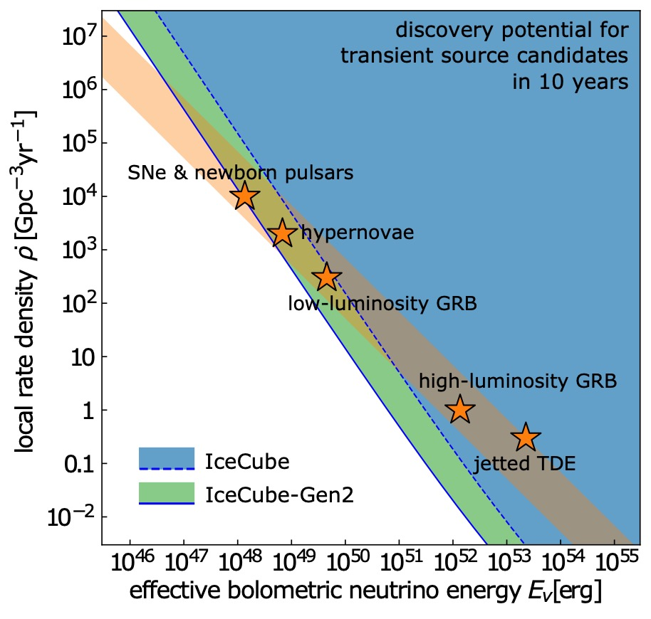
Many dim sources, or few bright sources?
If they are steady
or transient
“IceCube-Gen2: The Window to the Extreme Universe”
J. Phys. G: Nucl. Part. Phys. 48 060501 (2021)
Notes:
Comparison of the effective local density and luminosity of extragalactic neutrino source populations to the discovery potential of IceCube and IceCube-Gen2. We indicate several candidate populations (⭐) by the required neutrino luminosity to account for the full diffuse flux [48] (see also [111]). The orange band indicates the luminosity / density range that is compatible with the total observed diffuse neutrino flux. The lower (upper) edge of the band assumes rapid (no) redshift evolution. The shaded regions indicate Ice- Cube’s (blue, dashed line) and IceCube-Gen2’s (green, solid line) ability to discover one or more sources of the population. Right: The same comparison for transient neutrino sources parametrized by their local rate density and bolometric energy [113]. The ν μ + ν ̄ μ discovery potential for the closest source is based on 10 years of livetime (E2F
≃ 0.1 GeV/cm2 in the Northern Hemisphere [114]). Only the IceCube-Gen2 optical array has been considered for this figure.
Previous caption:
Left: Comparison of the diffuse neutrino emission (solid magenta band) to the effective local density and luminosity of extragalactic neutrino source populations. We indicate several candidate populations (⭐) by the required neutrino luminosity to account for the full diffuse flux [17] (see also [25]). The lower (upper) edge of the band assumes rapid (no) redshift evolution. The dark-blue-shaded region indicates IceCube’s discovery potential of the closest source of the population(E2φνμ+ν ̄μ ≃10−12TeV/cm2/sintheNorthernHemisphere[26]).Right:The same comparison for transient neutrino sources parametrized by their local density rate and bolometric energy [27]. The discovery potential of the closest source is based on 10 years of livetime (E2Fνμ+ν ̄μ ≃0.1GeV/cm2intheNorthernHemisphere[28]).
10^6 * 10^39 = 10^45
10^-3 * 10^48 = 10^45
Magenta band has slope -1

Slide 30
IceCube-Gen2: the next generation
“IceCube-Gen2: The Window to the Extreme Universe”
J. Phys. G: Nucl. Part. Phys. 48 060501 (2021)
Notes:
PINGU LOI: 1401.2046

Slide 31
IceCube Upgrade (first step toward Gen 2): fully funded with construction underway
Notes:
Slide from Marek Kowalski @ IPA 2017

Slide 32
KM3Net and Baikal-GVD construction proceeding well
KM3Net ORCA: dense array for low-energy neutrinos
KM3Net ARCA: large array for high-energy neutrinos
up-going
down-going
Detection of atmospheric neutrinos with 19 days of partial ARCA
(A. Sinopoulou for KM3NeT, ICRC 2021)
Projected effective volume of
ARCA and ORCA
(P. Coyle for KM3NeT, ICRC 2021)
Notes:
Left image taken from P. Coyle @ ICRC 2021 slides

Slide 33
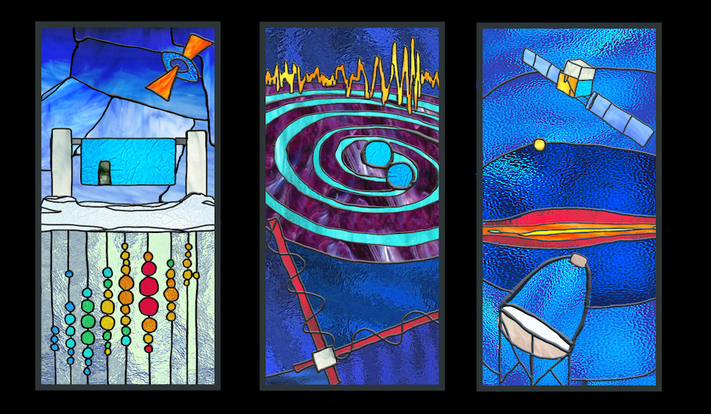
Conclusions and Outlook
Neutrino astronomy is now a reality and a key component of multi-messenger astrophysics
Total (“diffuse”) astrophysical neutrino signal discovered
Continuous improvements in quantification of spectrum, isotropy, flavor ratio
Initial evidence for individual sources has emerged
The neutrino (hadronic) sky is likely as surprising and diverse as the electromagnetic sky
Likely multiple source classes. What are they?
Next-generation instruments (KM3NeT, Baikal-GVD, IceCube Upgrade, IceCube Gen2, P-ONE) under construction and planned
Notes:
Additional interesting source classes: supernovae, radio galaxies
Non-detection of neutrinos in coincidence with gravitational waves or fast radio bursts
Whether transient or not, there must be >10² neutrino sources

Slide 34
High-energy neutrino contributions at TAUP 2021
Ali Kheirandish, High-energy neutrinos from supernovae: prospects for identification in current and future neutrino telescopes (8/30 parallel)
Silvia Celli, KM3NeT: Status and perspectives for neutrino astronomy from the MeV to the PeV (8/30 parallel)
Viviana Niro, Neutrinos from Galactic sources (8/30 parallel)
Islam Unatlokov, Search for neutrino counterparts of LIGO/Virgo gravitational waves (8/30 parallel)
Peter Denton, Visible decay of astrophysical neutrinos at IceCube (8/30 parallel)
Andrew Cheek, Dark matter physics in neutrino telescopes and neutrino physics in dark matter detectors (8/30 parallel)
Soumya Sadhukhan, IceCube PeV events and NSI: role of charged Higgs (8/30 parallel)
Iván Esteban, Probing secret interactions of astrophysical neutrinos in the high-statistics era
Damiano F.G. Fiorillo, IceCube constraints on violation of the equivalence principle (8/31 parallel)
Soebur Razzaque, Line of sight PeV-EeV neutrinos from gamma-ray blazars due to ultrahigh-energy cosmic-ray propagation (8/31 parallel)
Chiara Poirè, Indirect dark matter searches towards the Sun with ANTARES neutrino telescope (9/1 parallel)
Philip Ruehl, Multimessenger astronomy of transient point sources at the Pierre Auger Observatory (9/1 parallel)
Viktor Romanenko, Searches for sub-PeV photons in coincidence with neutrinos (9/1 parallel)
Pablo Correa, Searching for high-energy neutrinos from ultra-luminous infrared galaxie with IceCube (9/1 parallel)
Gonzalo Parente, The search for ultra-high energy neutrinos through highly inclined air showers in the Pierre Auger Observatory (9/1 parallel)
Najia Moureem Binte Amin, Implementation of IceTop data in the IceCube realtime alert system (9/1 parallel)
Antonio Ambrosone, A novel multimessenger study of starburst galaxies: implications for neutrino astronomy (9/2 parallel)
Umut Kose, Measuring high-energy neutrinos with FASERnu in the LHC Run-3 (9/2 parallel)
Jose Carpio, Time delay distributions of neutrino echoes induced by secret neutrino interactions (9/2 parallel)
Notes:
MeV:
Maria Cristina Volpe, Neutrinos: from the r-process to the diffuse supernova neutrino background (8/30 parallel)
Shuhei Obara, Search for supernova relic neutrinos at KamLAND (8/30 parallel)
Sayan Ghosh, Simulation of recoils due to supernova neutrino-induiced neutrons in liquid xenon detectors (8/30 parallel)
Marta Colomer Molla, SNEWS 2.0: the multi-messenger supernova early warning system (8/30 parallel)
Ko Nakamura, Core-collapse simulation of SN1987A binary progenitor and its multimessenger signals (9/1 parallel)
Xin Huang, Detection of core-collapse supernova neutrino at JUNO (9/1/ parallel)
Artem Popov, Effects of nonzero Majorana CP phases on oscillations of supernova neutrinos
Minori Eizuka, Supernova neutrino burst search at KamLAND (9/1 parallel)
Giulia Pagliaroli, Looking for core-collapse supernovae with gravitational waves and low-energy neutrinos (9/2 parallel)
Sebastian Baum, Paleo-detectors – digging for dark matter (and neutrinos) (9/2 parallel)j
Also:
Emma Rébert, Update on the characterization of the pGCT, a 4m-prototype telescope built as part of the Cherenkov Telescope Array project (9/2 parallel)
Andrii Neronov, Multimessenger astronomy (8/30 plenary)
Kei Kotake, Supernovae: neutrinos and gravitational waves (8/27 plenary)

Slide 35
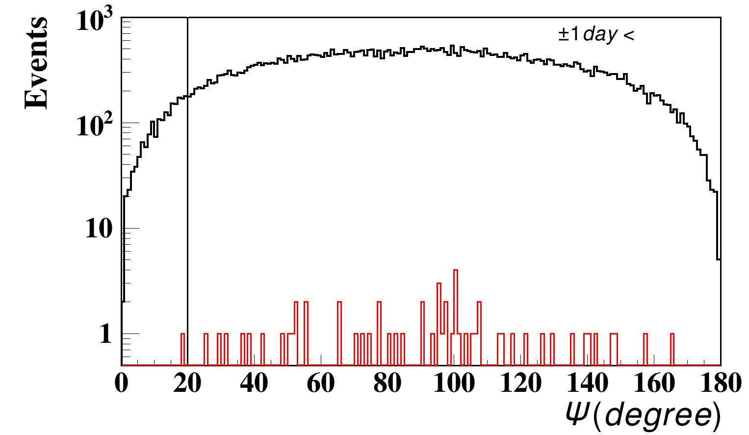
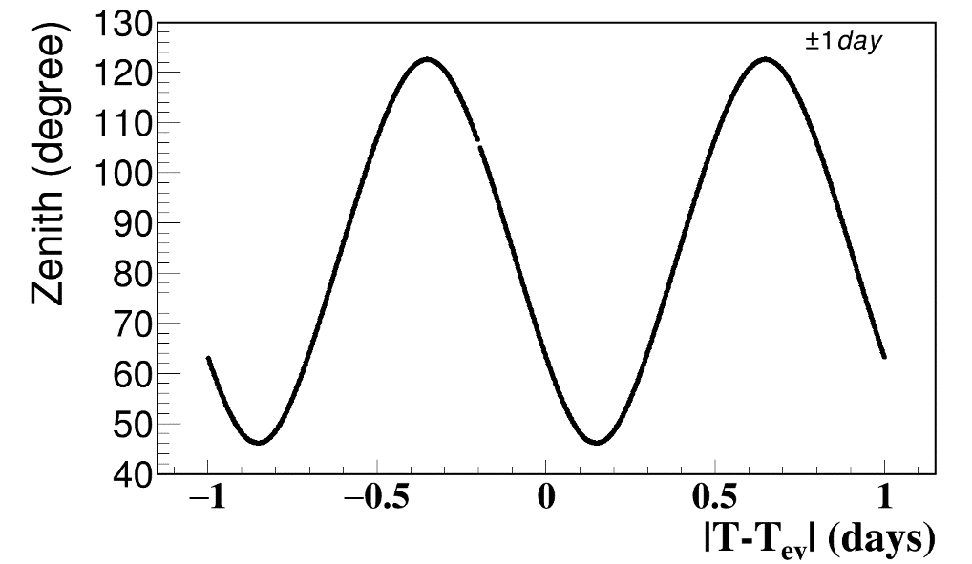
Baikal-GVD search for 𝜈s ± 1 day around IC170922A
Angular distance from the source
Source direction at GVD site
(zenith angle 45°< θ <126°
No GVD events associated with IC170922A

Slide 36
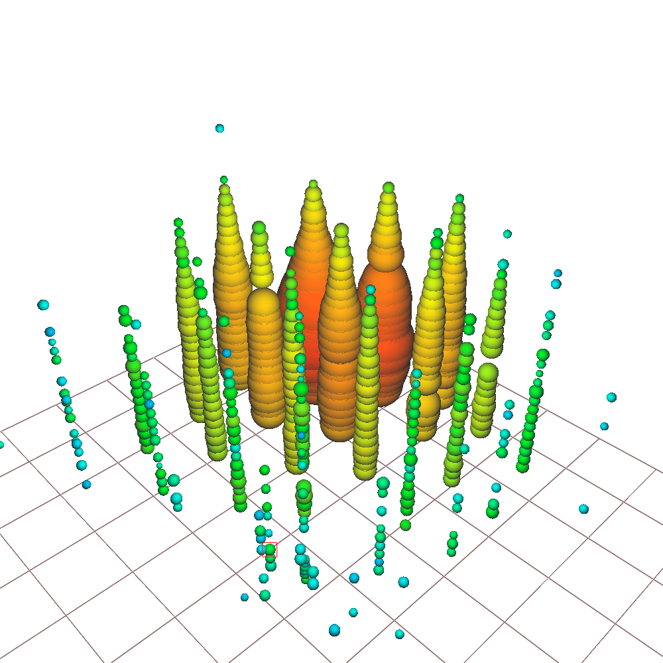
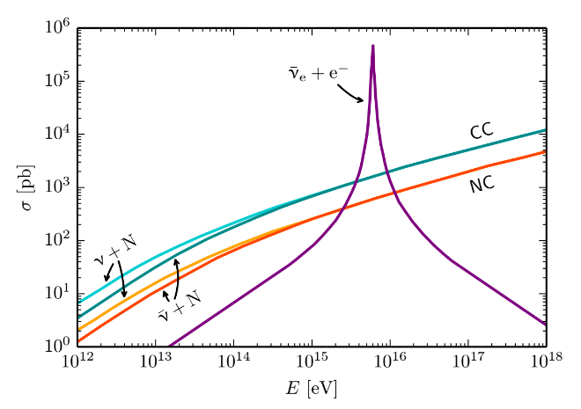
Glashow resonance event
Resonance:
E_{ν} = 6.3 PeV
Event not contained: identified in partially contained PeV search (PEPE)
IceCube, 1710.01191 (ICRC)
6.05 ± 0.72 PeV visible energy
IceCube, Nature 591, 220-224 (2021)
Notes:
Low energy muons produced in hadronic shower
Astrophysical origin: 5 sigma
Glashow identity: 2.3 sigma
W and Z discovered by UA1 and UA2, CERN 1983
W decay modes
Highest energy anti-particle ever identified
Highest energy neutrino ever detected

Slide 37
Search for diffuse Galactic neutrinos
Model:
Gaggero et al. PRL 2017, 119
Galactic neutrinos are expected from both diffuse emission and discrete sources
Measurements of diffuse 1-500 TeV Galactic diffuse neutrinos will complement 0.2-300 GeV gamma-ray measurements
See also IceCube, ApJ 849:67 (2017): <14% of diffuse 𝜈 flux is Galactic
Notes:
Figure 2. Upper limits at the 90% confidence level on the three-flavor (1:1:1 flavor ratio assumption) neutrino flux from the Galaxy with respect to KRA model predictions and the measured astrophysical flux. Fluxes are integrated over the whole sky for uniform comparison. The IceCube 7-year upper limit for the KRA-γ (50 PeV) model test for the ps-template method is shown in red. The energy range of validity is from 1 to 500 TeV. This range is calculated by finding the low- and high-energy thresholds where removing simulated signal events outside these values decreases the sensitivity by 5% each. The ANTARES limit in blue (Adrián-Martínez et al. 2016a), directly applicable in the Galactic center region (-40° < l < 40° and -3° < b < 3°), has been scaled to represent an all-sky integrated flux for comparison. Due to ANTARES being located in the northern hemisphere, it has a relatively high sensitivity in the southern sky near the Galactic center region using muon neutrinos. The range of predictions for all the KRA models (Gaggero et al. 2015) is shown as the gray band, with the top of that band representing the KRA-γ (50 PeV) model. The model by Ingelman & Thunman (Ingelman & Thunman 1996) is shown in purple. For comparison, measurements of the all- sky diffuse flux are shown: a differential unfolding (black points) and a power- law unfolding (yellow band) of combined IceCube data sets from Aartsen et al. (2015a), as well as a measurement based only on northern sky muon data (green band), from Aartsen et al. (2016).
Models: D. Gaggero et al. ApJL 815, L25 (2015)
From Gaggero et al:
“Following (Gaggero et al. 2014), the starting point is a conventional propagation setup characterized by δ = 0.5, compatible with a Kraichnan spectrum of the interstellar turbulence within the quasi-linear theory framework. We will refer to this setup as the “KRA model” (see also Evoli et al. 2011).”
delta is defined by D(rho) propto (rho/rho_0)^delta
Paper abstract:
The origins of high-energy astrophysical neutrinos remain a mystery despite extensive searches for their sources. We present constraints from seven years of IceCube Neutrino Observatory muon data on the neutrino flux coming from the Galactic plane. This flux is expected from cosmic-ray interactions with the interstellar medium or near localized sources. Two methods were developed to test for a spatially extended flux from the entire plane, both of which are maximum likelihood fits but with different signal and background modeling techniques. We consider three templates for Galactic neutrino emission based primarily on gamma-ray observations and models that cover a wide range of possibilities. Based on these templates and in the benchmark case of an unbroken E-2.5 power-law energy spectrum, we set 90% confidence level upper limits, constraining the possible Galactic contribution to the diffuse neutrino flux to be relatively small, less than 14% of the flux reported in Aartsen et al. above 1 TeV. A stacking method is also used to test catalogs of known high-energy Galactic gamma-ray sources.

Slide 38
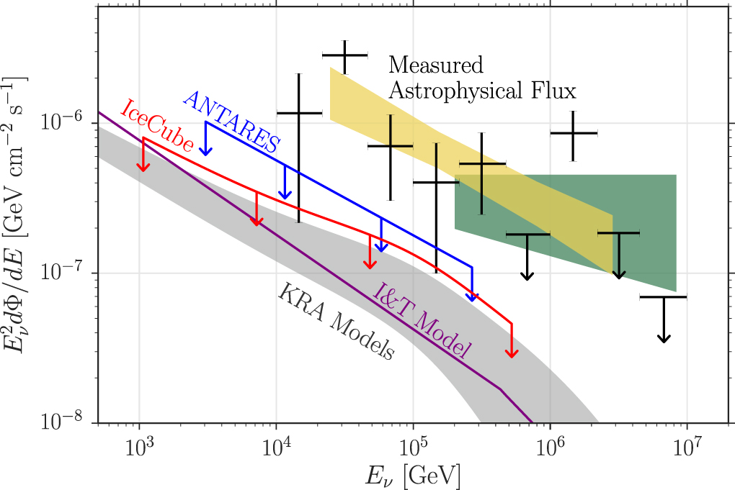
Search for diffuse Galactic neutrinos
IceCube, ApJ 849:67 (2017)
<14% of diffuse 𝜈 flux is Galactic
Galactic neutrinos are expected from both diffuse emission and discrete sources
Measurements of diffuse 1-500 TeV Galactic diffuse neutrinos will complement 0.2-300 GeV gamma-ray measurements
Notes:
Figure 2. Upper limits at the 90% confidence level on the three-flavor (1:1:1 flavor ratio assumption) neutrino flux from the Galaxy with respect to KRA model predictions and the measured astrophysical flux. Fluxes are integrated over the whole sky for uniform comparison. The IceCube 7-year upper limit for the KRA-γ (50 PeV) model test for the ps-template method is shown in red. The energy range of validity is from 1 to 500 TeV. This range is calculated by finding the low- and high-energy thresholds where removing simulated signal events outside these values decreases the sensitivity by 5% each. The ANTARES limit in blue (Adrián-Martínez et al. 2016a), directly applicable in the Galactic center region (-40° < l < 40° and -3° < b < 3°), has been scaled to represent an all-sky integrated flux for comparison. Due to ANTARES being located in the northern hemisphere, it has a relatively high sensitivity in the southern sky near the Galactic center region using muon neutrinos. The range of predictions for all the KRA models (Gaggero et al. 2015) is shown as the gray band, with the top of that band representing the KRA-γ (50 PeV) model. The model by Ingelman & Thunman (Ingelman & Thunman 1996) is shown in purple. For comparison, measurements of the all- sky diffuse flux are shown: a differential unfolding (black points) and a power- law unfolding (yellow band) of combined IceCube data sets from Aartsen et al. (2015a), as well as a measurement based only on northern sky muon data (green band), from Aartsen et al. (2016).
Models: D. Gaggero et al. ApJL 815, L25 (2015)
From Gaggero et al:
“Following (Gaggero et al. 2014), the starting point is a conventional propagation setup characterized by δ = 0.5, compatible with a Kraichnan spectrum of the interstellar turbulence within the quasi-linear theory framework. We will refer to this setup as the “KRA model” (see also Evoli et al. 2011).”
delta is defined by D(rho) propto (rho/rho_0)^delta
Paper abstract:
The origins of high-energy astrophysical neutrinos remain a mystery despite extensive searches for their sources. We present constraints from seven years of IceCube Neutrino Observatory muon data on the neutrino flux coming from the Galactic plane. This flux is expected from cosmic-ray interactions with the interstellar medium or near localized sources. Two methods were developed to test for a spatially extended flux from the entire plane, both of which are maximum likelihood fits but with different signal and background modeling techniques. We consider three templates for Galactic neutrino emission based primarily on gamma-ray observations and models that cover a wide range of possibilities. Based on these templates and in the benchmark case of an unbroken E-2.5 power-law energy spectrum, we set 90% confidence level upper limits, constraining the possible Galactic contribution to the diffuse neutrino flux to be relatively small, less than 14% of the flux reported in Aartsen et al. above 1 TeV. A stacking method is also used to test catalogs of known high-energy Galactic gamma-ray sources.

Slide 39
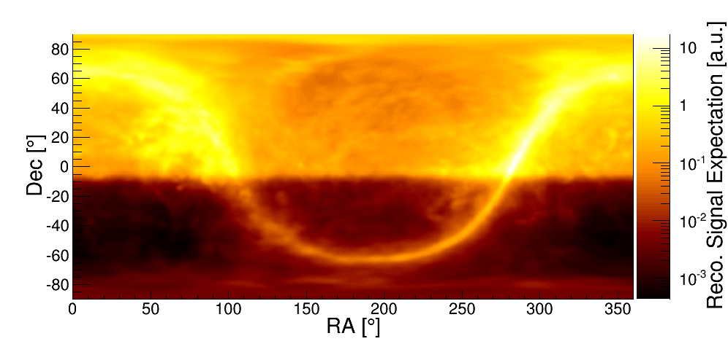
Search for Galactic neutrinos: diffuse spatial template
IceCube, ApJ 849:67 (2017)
Based on Fermi 𝜋⁰ template combined with IceCube effective area and angular resolution (forward folding)
Also tested models from Ingelman & Thunman (1996), Gaggero et al. 2015
Notes:
Figure 2. Upper limits at the 90% confidence level on the three-flavor (1:1:1 flavor ratio assumption) neutrino flux from the Galaxy with respect to KRA model predictions and the measured astrophysical flux. Fluxes are integrated over the whole sky for uniform comparison. The IceCube 7-year upper limit for the KRA-γ (50 PeV) model test for the ps-template method is shown in red. The energy range of validity is from 1 to 500 TeV. This range is calculated by finding the low- and high-energy thresholds where removing simulated signal events outside these values decreases the sensitivity by 5% each. The ANTARES limit in blue (Adrián-Martínez et al. 2016a), directly applicable in the Galactic center region (-40° < l < 40° and -3° < b < 3°), has been scaled to represent an all-sky integrated flux for comparison. Due to ANTARES being located in the northern hemisphere, it has a relatively high sensitivity in the southern sky near the Galactic center region using muon neutrinos. The range of predictions for all the KRA models (Gaggero et al. 2015) is shown as the gray band, with the top of that band representing the KRA-γ (50 PeV) model. The model by Ingelman & Thunman (Ingelman & Thunman 1996) is shown in purple. For comparison, measurements of the all- sky diffuse flux are shown: a differential unfolding (black points) and a power- law unfolding (yellow band) of combined IceCube data sets from Aartsen et al. (2015a), as well as a measurement based only on northern sky muon data (green band), from Aartsen et al. (2016).
Models: D. Gaggero et al. ApJL 815, L25 (2015)
From Gaggero et al:
“Following (Gaggero et al. 2014), the starting point is a conventional propagation setup characterized by δ = 0.5, compatible with a Kraichnan spectrum of the interstellar turbulence within the quasi-linear theory framework. We will refer to this setup as the “KRA model” (see also Evoli et al. 2011).”
delta is defined by D(rho) propto (rho/rho_0)^delta
Paper abstract:
The origins of high-energy astrophysical neutrinos remain a mystery despite extensive searches for their sources. We present constraints from seven years of IceCube Neutrino Observatory muon data on the neutrino flux coming from the Galactic plane. This flux is expected from cosmic-ray interactions with the interstellar medium or near localized sources. Two methods were developed to test for a spatially extended flux from the entire plane, both of which are maximum likelihood fits but with different signal and background modeling techniques. We consider three templates for Galactic neutrino emission based primarily on gamma-ray observations and models that cover a wide range of possibilities. Based on these templates and in the benchmark case of an unbroken E-2.5 power-law energy spectrum, we set 90% confidence level upper limits, constraining the possible Galactic contribution to the diffuse neutrino flux to be relatively small, less than 14% of the flux reported in Aartsen et al. above 1 TeV. A stacking method is also used to test catalogs of known high-energy Galactic gamma-ray sources.

Slide 40
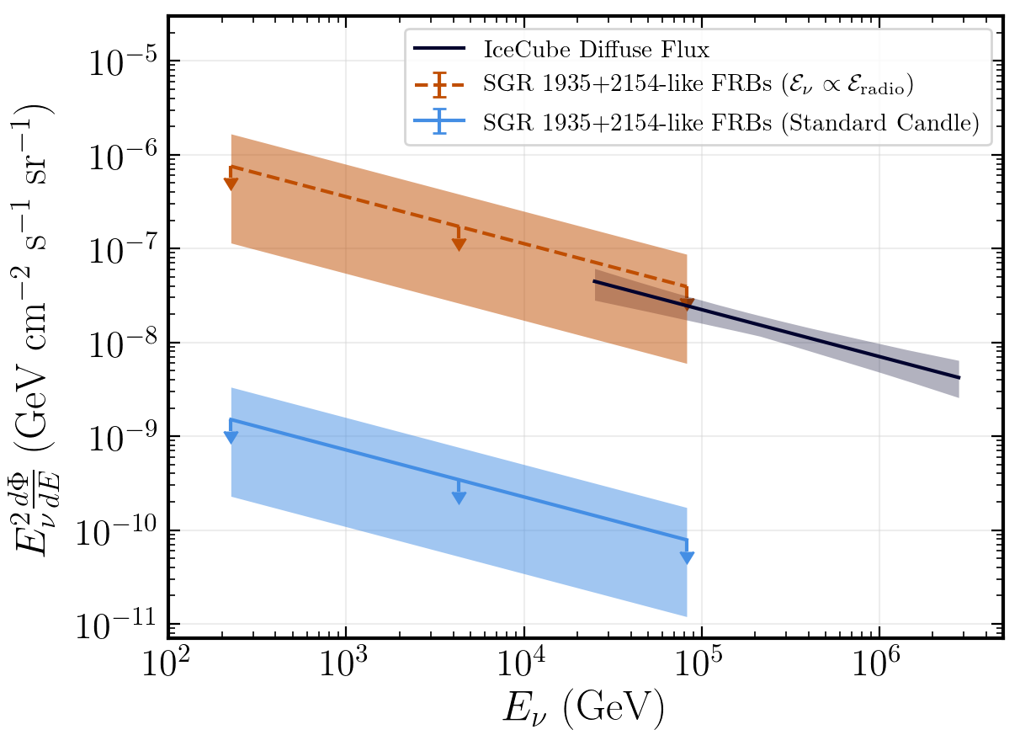
FRB/magnetar/SGR neutrino emission?
IceCube, ATel #13266
IceCube, ApJ 910:4 (2021)
FRB 200428 (CHIME and STARE2) associated with soft gamma repeater(magnetar) J1935+2154 through coincident X-ray emission
Subsequent radio bursts established the FRB as a repeater
Notes:
Figure 8. Upper limits on the contribution to the diffuse neutrino flux from a population of FRBs similar to that from SGR 1935+2154, for a variety of luminosity functions. The rate of such a population is taken from Bochenek et al. (2020), and the limit on the neutrino luminosity is derived from our analysis of FRB 200428. For a naive standard candle assumption (light blue), the strict upper limit from the Galactic burst limits the contribution of FRBs to be less than 1% of the diffuse astrophysical neutrino flux. However, if the emitted energy in neutrinos were to scale linearly with the energy emitted at radio wavelengths (dashed orange), as described in the text, then FRBs are not ruled out as contributing significantly to the diffuse neutrino flux. The band on each of these limits represents the uncertainty on the reported volumetric rate of these transients.

Slide 41
ANITA-IceCube: multi-wavelength neutrino astronomy?
ANITA Anomalous Event 141220
IceCube, ApJ 892:53 (2020)
ANITA anomalous events due to a transient astrophysical source?
Would be accompanied by a TeV-PeV signal in IceCube, regardless of source spectrum (cascading downward in Earth during propagation)
No IceCube counterpart detected
Notes:
Figure 1. Sky maps (top) and TS distributions (bottom) for AAE-141220 for the prompt (left), rolling (middle), and steady (right) analyses. Observed TS values (shown in red) are compared to distributions from time-scrambled data realizations to quantify the significance. In all sky maps, solid (dotted) lines represent 50% (99%) containment of the reconstructed direction of the events. In the prompt analysis sky map, the best-fit location of each IceCube event is represented with a cross, and the size of the circle represents the uncertainty (50% containment) on the event’s reconstruction, with color representing the IceCube event arrival time relative to the ANITA event. Both the sky map and TS distribution for this analysis are for the 105 s time window. In the rolling and steady analysis sky maps, color reflects the TS values defined in Sections 3.2 and 3.3 respectively.
Figure 5. Upper limits (90% C.L.) placed by calculating the secondary neutrino flux (purple histogram) from an incident flux of EeV neutrinos assuming constant emission over 103 s and comparing to the nonobservation of IceCube events in the prompt analysis described in Section 3.1 for AAE141220. The flux implied by the ANITA observations (black), represented in this figure as En n nn FD = D F 0 T E T E t dE ò ( ) , , using information about ANITA’s acceptance (Romero-Wolf et al. 2019) overshoots this upper limit (purple arrow) by many orders of magnitude. For comparison, upper limits on the time-integrated muon neutrino flux from the prompt analysis are shown in blue. All fluxes are per flavor n n + ¯.

Slide 42
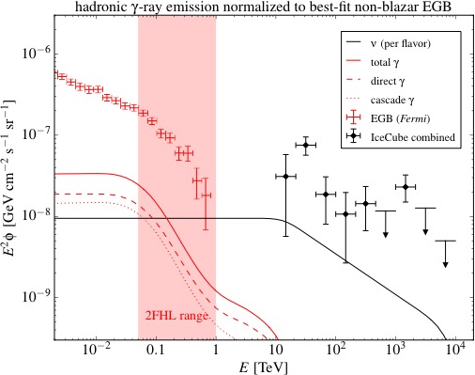
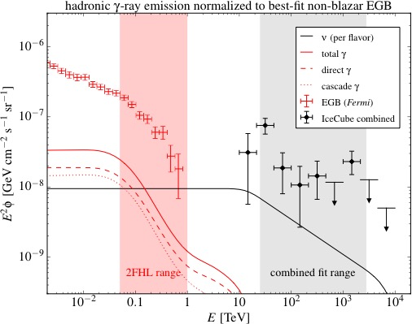
The neutrinos are not produced predominantly by star-forming galaxies
Maximum non-blazar gamma-ray spectrum
Corresponding neutrino spectrum
Bechtol, Ahlers, Di Mauro, Ajello, Vandenbroucke, ApJ 836:47 (2017)
Notes:
The total measured extragalactic background (EGB) spectrum is shown (red points), along with the maximum component that could be due to star-forming galaxies (red line). The corresponding calculated neutrino spectrum is shown as a black line, compared to the IceCube measured spectrum. Star-forming galaxies can explain some but not most of the IceCube signal. [9]
8 star-forming galaxies detected by LAT:
non-starbursts MW, M31 (Andromeda), LMC, SMC
starbursts M82, NGC 253, NGC 2146, Arp 220

Slide 43
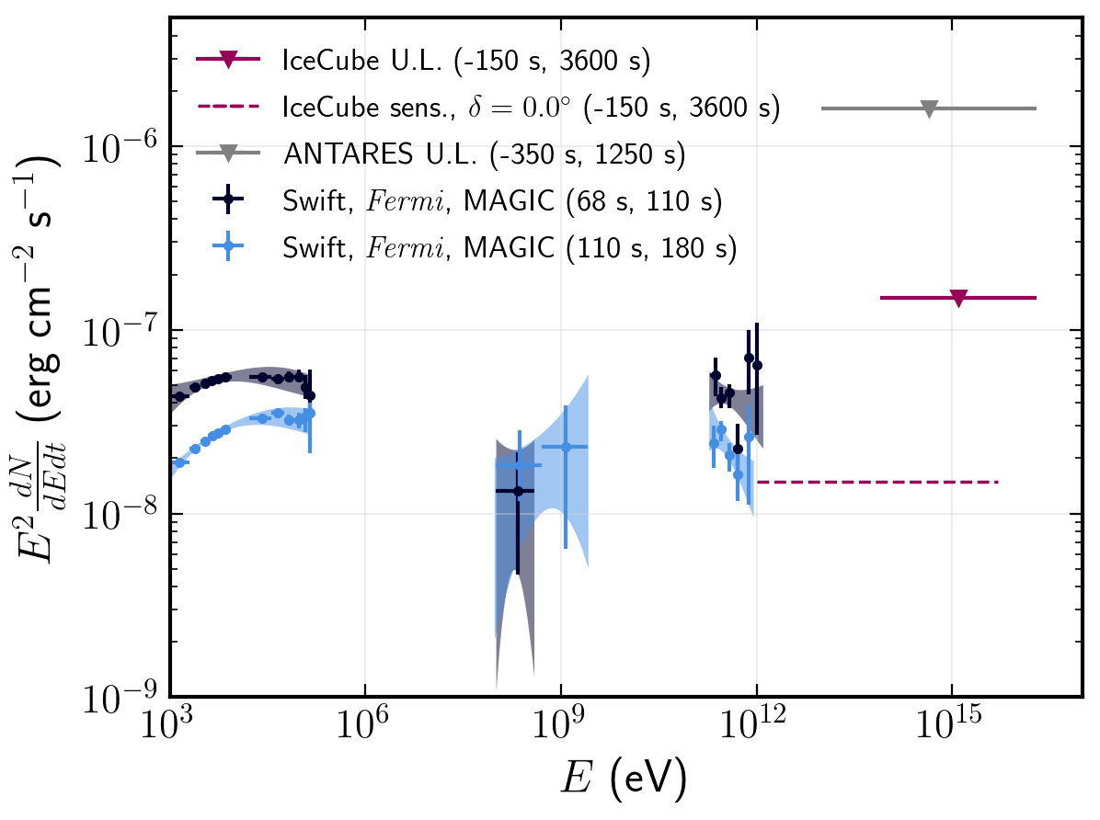
Dedicated neutrino analyses of GRB 190114C
(TeV detected by MAGIC, -27°declination)
IceCube, ATel #12395
IceCube, arXiv:2012.04577
ANTARES, Neutrino 2020
and ARIANNA, ATel #12475
Notes:
Figure 1: ANTARES 90% differential (black arrows) and integrated (violet line) UL as a function of the neutrino energy, evaluated over 0.44 h assuming an E −2 neutrino spectrum. The predicted time integrated neutrino flux over 39 s by the NeuCosmA model [5] is computed using the GRB parameters as measured by Fermi-GBM, and for two different Lorentz factors (green and red lines). MAGIC fluence normalisation for the first time bin (62-110s, blue band), and for the overall time window (62-2400s, orange band)
Figure 7. Multiwavelength and multimessenger spectra for GRB 190114C. Observation time windows are indicated in the legend. Neutrino upper limits are shown assuming an E −2 flux, and span the central 90% of the expected energies of neutrino events for this spectral assumption. The ANTARES limit is taken from Molla (2020). Data points across the electromagnetic spectrum are taken from Acciari et al. (2019b) and are shown for two time intervals. The lowest energy band represents the 90% confidence contours from a joint fit of Swift-BAT and Swift-XRT data, and the GeV and TeV bands are the 1σ contour regions from the best-fit power-law functions from Fermi-LAT and MAGIC, respectively. For comparison, we show the sensitivity (dashed magenta) this analysis would have for the same observation time window for a source at the horizon, where the sensitivity is optimal.

Slide 44
IceCube data release and TXS 0506+056
IceCube, arXiv:2101.09836

Slide 45
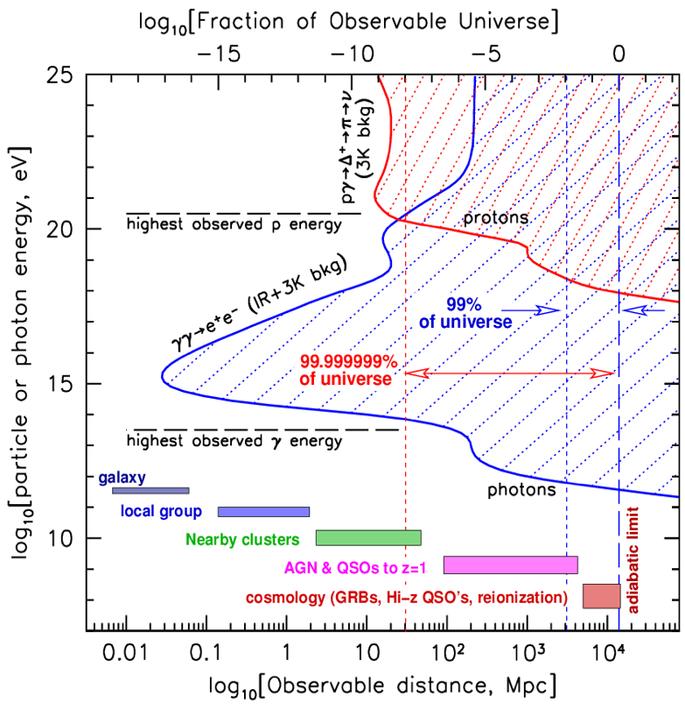
Neutrinos see to great energies and distances
100 EeV
1 TeV
Notes:
Redshift of 0.1 tau=1 for 1 TeV
z = 0.01: 40 Mpc
z = 0.1: 400 Mpc
z = 1: 4 Gpc
TODO: Z burst back of envelope

Slide 46
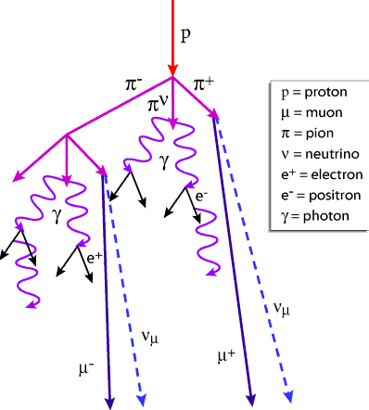
Signals and backgrounds in neutrino telescopes
Atmospheric muons: 70 billion per year
Atmospheric neutrinos: one in ~10⁶
Astrophysical neutrinos: one in ~10⁹
Rates for a km³ telescope
Notes:
Francis: 550 cosmic neutrinos in the Aachen analysis on a background of 340,000
Waxman-Bahcall is scaled by 3/2 (why?)
Atmospheric neutrino production:
Cosmic rays produce muons, pions, kaons which decay to neutrinos
Toward horizon, more atmosphere column depth within which particles can decay before being absorbed by Earth
Prompt/charm: don’t need path length to decay

Slide 47
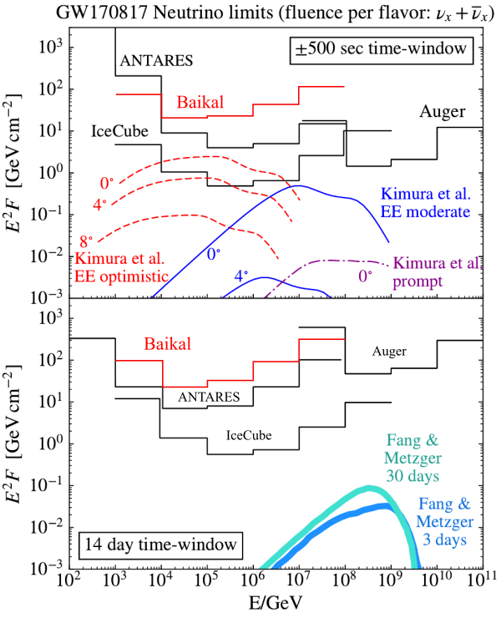
ANTARES, Auger, GVD, IceCube analysis of BNS merger GW 170817
No neutrino events associated with GW170817A found in cascade search within ± 500 seconds or +14 days
Assuming E⁻² and equal fluence in all flavors, upper limits at 90% have been
derived on the neutrino fluence from
GW170817 for each energy decade.
GVD, JETP Lett. 108 (2018) no.12, 787-790

Slide 48
IceCube alerts optical, X-ray, and gamma-ray observatories where and when to point
Real time (~1 minute) public alerts since 2016
Now 20-30 alerts per year
IceCube, Astropart. Phys. 92 (2017) 30-41
Notes:
https://gcn.gsfc.nasa.gov/amon_ehe_events.html (8 as of Mar 27 2019)
https://gcn.gsfc.nasa.gov/amon_hese_events.html (15 as of Mar 27 2019)
17+9-1=25 total
First alert issued April 27, 2016
As of May 21 2019: 37 months of alerts
25 / (3.1) = 8.1 per year
Most recent Feb 21, 2019 (as of Mar 27 2019: 35 months of alerts)
HESE events:
1) 160427
2) 160731 (also EHE)
4) 160814
5) 161103
7) 170312
9) 170506
11) 171015
12) 171028
14) 180423
16) 181014
17) 181031
18) 190104
19) 190124
20) 190205
21) 190221
22) 190331
23) 190504
EHE events:
2) 160731 1:55:04.00 [GCN 1:55:45 HESE and 1:55:58 EHE; revised 160801 2:35:38 HESE and 2:35:54 EHE]
3) 160806 12:21:33.00 [GCN 12:22:10]; latency (22*60+10) – (21*60+33.00) = 37 sec
6) 161210 20:06:40.31 [GCN 20:07:16; revised 161211 16:04:50]; latency (7*60+16) - (6*60+40.31) = 35.69 sec
8) 170321 07:32:20.69 [GCN 7:32:58]; latency = (32*60+58) - (32*60+20.69) = 37.31 sec
10) 170922 20:54:30.43 [GCN 20:55:13]: latency = (55*60+13) - (54*60+30.43) = 42.57 sec
13) 171106 18:39:39.21 [GCN 18:40:24]: latency = (40*60+24) - (39*60+39.21) = 44.79 sec sec
15) 180908
17) 181023
18) 190503
But when did EHE start?
Rate: 22 / 2.9 = 7.5 alerts per year
IceCube, 1309.6979 (ICRC)
IceCube, 1908.04884 (ICRC)

Slide 49
Outline
Neutrino sources across the energy spectrum
Neutrinos as cosmic messengers
Neutrino telescopes around the world
Signals and backgrounds
Measurements of the total TeV-PeV spectrum
Searches for individual sources
Conclusion and outlook

Slide 50
ANTARES likelihood analysis
https://iopscience.iop.org/article/10.3847/1538-4357/abe53c

Slide 51
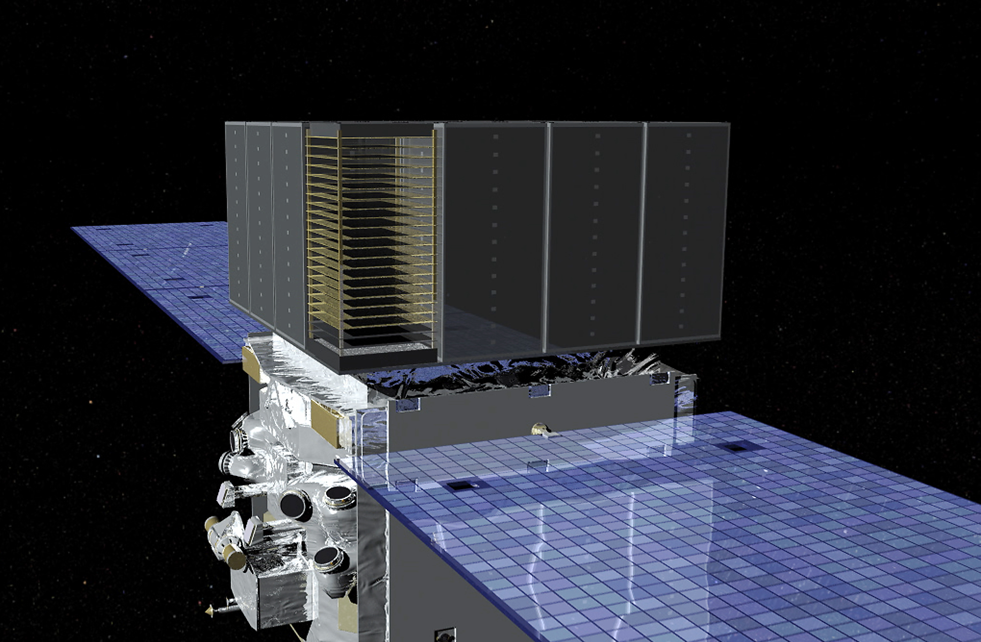
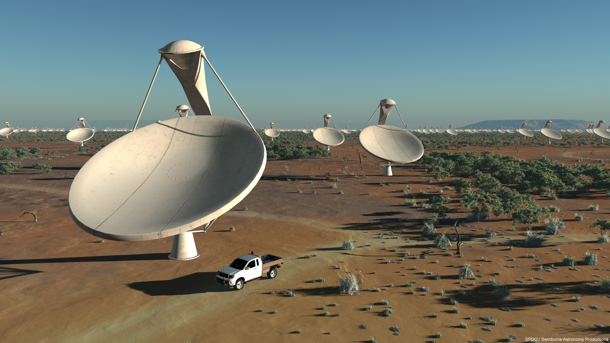
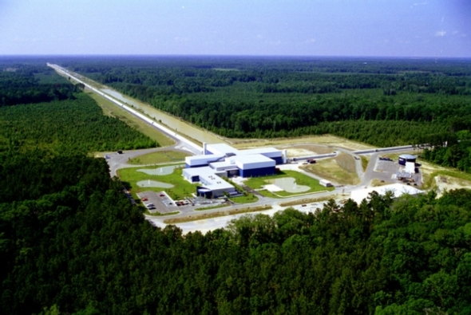
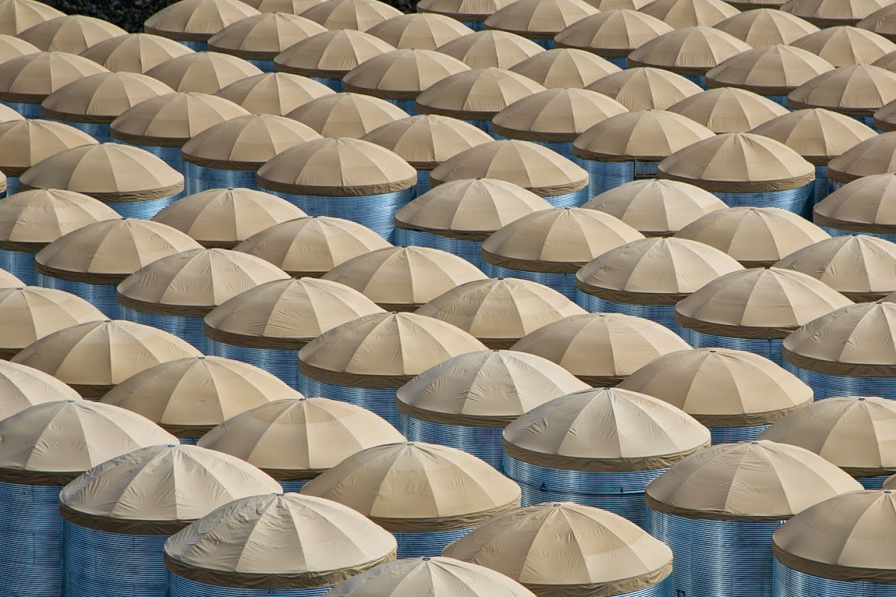
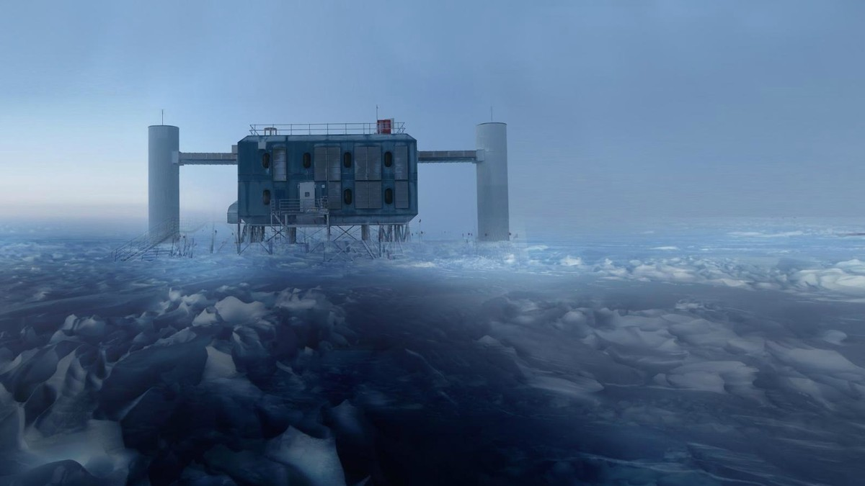
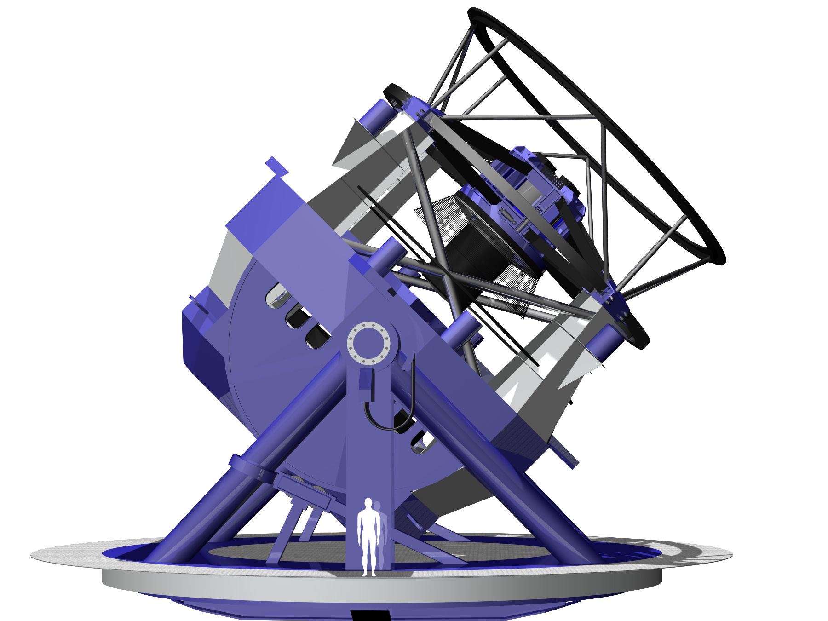
Outlook: A new era of astrophysics with multiple messengers
Fermi
SKA
LIGO, Virgo, KAGRA
HAWC, LHAASO, SWGO
KM3Net, GVD, IceCube (Gen 2)
Rubin Observatory
CTA

Slide 52
A neutrino coincident with a tidal disruption event
Days since discovery
R. Stein et al., 2005.05340, Nat Astron 5, 510-518 (2021)
Bright, radio-emitting TDE found coincident with IC191001A
Accounting for 8 neutrino campaigns and TDE density, chance coincidence probability is 0.5%
Suggests TDEs contribute to astrophysical neutrino flux (>3% of total)
Notes:
Figure 1: Multi-wavelength lightcurve of AT2019dsg. Error bars represent 1σ intervals. The upper panel shows the optical photometry from ZTF, alongside UV observations from Swift-UVOT. The plateau luminosity is a factor of 10 brighter in UVW2 than the pre-disruption baseline of the host galaxy. The lower panel shows the integrated X-ray energy flux, from observations with Swift-XRT and XMM-Newton, in the energy range 0.3-10 keV. Arrows indicated 3σ upper limits. The vertical dotted line illustrates the arrival of IC191001A.

Slide 53
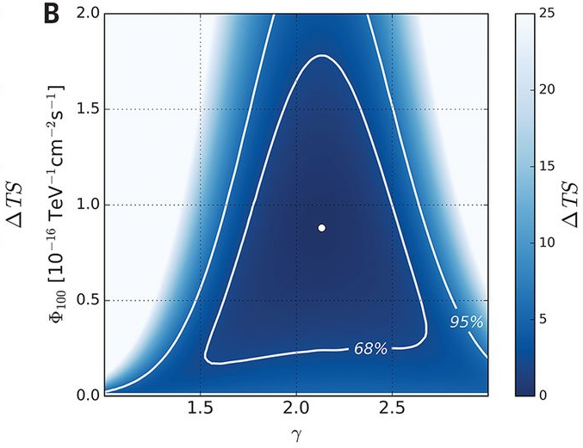
Archival IceCube data in the blazar direction
First 7 years
Entire 9.5 year archive (time-integrated): 4.1 𝜎
First 7 years (excluding 170922A): 2.1 𝜎 (p = 1.6%)
Notes:
As in Fig. 3A, but for the time-integrated analysis of TXS 0506+056 using (A) the full 9.5-year sample (2008–2017), and (B) the 7-year sample (2008–2015).

Slide 54


Archival IceCube data in the blazar direction
3.5 𝜎 evidence for a neutrino flare in late 2014 – early 2015 (long before 170922A)
  158 day duration (box profile)
  110 day duration (Gaussian)
13±5 excess neutrinos above atmospheric background
Notes:
The orange curve corresponds to the analysis using the Gaussian-shaped time profile. The central time T₀ and width T_{W} are plotted for the most significant excess found in each period, with the P value of that result indicated by the height of the peak. The blue curve corresponds to the analysis using the box-shaped time profile. The curve traces the outer edge of the superposition of the best-fitting time windows (durations T_{W}) over all times T₀, with the height indicating the significance of that window. In each period, the most significant time window forms a plateau, shaded in blue. The large blue band centered near 2015 represents the best-fitting 158-day time window found using the box-shaped time profile. The vertical dotted line in IC86c indicates the time of the IceCube-170922A event.
Skymap showing the P value of the time-dependent analysis performed at the coordinates of TXS 0506+056 (cross) and at surrounding locations. The analysis is performed on the IC86b data period, using the Gaussian-shaped time window. At each point, the full fit for (Φ, γ, T₀, T_{W}) is performed. The P value shown does not include the look-elsewhere effect related to other data periods. An excess of events is detected, consistent with the position of TXS 0506+056.

Slide 55
Fast radio bursts / magnetars: neutrino emission?
Metzger et al.,
ApJ 902:L22 (2020)
Emission may be powered by a baryon-loaded shock, which could also produce 𝜈s
Notes:
Abstract
The discovery of a luminous radio burst, FRB 200428, with properties similar to those of fast radio bursts (FRBs), in coincidence with an X-ray flare from the Galactic magnetar SGR 1935+2154, supports magnetar models for cosmological FRBs. The burst's X-ray to radio fluence ratio, as well as the X-ray spectral shape and peak energy, are consistent with FRB 200428 being the result of an ultra-relativistic shock (powered, e.g., by an ejected plasmoid) propagating into a magnetized baryon-rich external medium; the shock simultaneously generates X-ray/gamma-rays via thermal synchrotron emission from electrons heated behind the shock, and coherent radio emission via the synchrotron maser mechanism. Here, we point out that a unique consequence of this baryon-loaded shock scenario is the generation of a coincident burst of high-energy neutrinos, generated by photohadronic interaction of relativistic ions—heated or accelerated at the shock—with thermal synchrotron photons. We estimate the properties of these neutrino burst FRB counterparts and find that a fraction ~10⁻⁸–10⁻⁵ of the flare energy (or ~10⁻⁴–10⁻¹ of the radio isotropic energy) is channeled into production of neutrinos with typical energies ~TeV–PeV. We conclude by discussing prospects for detecting this signal with IceCube and future high-energy neutrino detectors.
Figure 2. Observed muon neutrino spectra for the same model in Figure 1, showing the growth of the spectra over decades in time as the shock propagates outwards. Shown for comparison are approximate IceCube sensitivity curves for observation windows of 30 ms and 17 s, corresponding roughly to the duration of neutrino emission from thermal and nonthermal protons, respectively, for a source distance of 0.1 kpc.

Slide 56

High-energy starting events (7.5 years)
103 events
Notes:
Figure 5: Arrival directions of the events in galactic coordinates. Shower-like events are marked with a + and those containing tracks with a ×. The new events of table 1 are shown in black. Colors show the test statistics (TS) for the point-source clustering test at each location. No significant clustering was found.
4 year was 6.5 sigma
2 of the 82 events have coincident muons
~8 sigma: Nancy Wandkowsky @ TeVPA 2017 (6 years of data)
More details on 6 year analysis:
1710.01191 (ICRC)
103 events out of which 60 have Edep > 60 TeV
75% astro purity above 60 TeV
Pink are new events in 7.5 yr analysis

Slide 57

Where are the TeV–PeV neutrinos coming from?
IceCube Collaboration,
Neutrino 2018
>8 sigma detection of astrophysical neutrinos
No significant clustering observed (103 events in 7.5 years)
Notes:
Figure 5: Arrival directions of the events in galactic coordinates. Shower-like events are marked with a + and those containing tracks with a ×. The new events of table 1 are shown in black. Colors show the test statistics (TS) for the point-source clustering test at each location. No significant clustering was found.
4 year was 6.5 sigma
2 of the 82 events have coincident muons
~8 sigma: Nancy Wandkowsky @ TeVPA 2017 (6 years of data)
More detials on 6 year analysis:
1710.01191 (ICRC)
TODO: dates of dataset; background fraction estimation and type of events; background fraction contamination for tracks vs. cascades
103 above ~20 TeV (cut is on Npe, not Edep)
https://wiki.icecube.wisc.edu/index.php/HESE-7_Plots_for_Approval
https://icecube.wisc.edu/~nwandkowsky/DiffuseNeutrinoPoster_v3.pdf
https://wiki.icecube.wisc.edu/images/0/08/HESE75_skymap_with_events_whyskip.png
HESE astrophysical diffuse detection in 6 years of data (82 events): 8 sigma

Slide 58
Gamma rays, neutrinos, and cosmic rays
all have ~equal energy density
L. Mohrmann, PhD thesis
Implies there is likely a strong connection among them
Despite this, sky looks very different in each messenger
Notes:
From Lars Mohrmann, DESY Zeuthen PhD thesis
E^2 dN/dE: erg^2 * /cm^2/erg/s = erg/cm^2/s
Nu F_nu: erg * erg/cm^2/erg/s = erg/cm^2/s
Figure 9.1 — Diffuse Neutrino, Photon, and Cosmic-Ray Fluxes.
The measurement of the diffuse cosmic neutrino flux obtained in this work (cf. fig. 8.11) is compared to measurements of the diffuse extragalactic γ-ray background by the Fermi LAT experiment [143] and measurements of the ultra-high-energy cosmic-ray flux by the Telescope Array experiment [7] and the Pierre Auger Observatory [8]. Upper limits are at one standard deviation confidence.

Slide 59

The IceCube Neutrino Observatory
IceTop (surface array): 81 stations
IceCube: 86 strings
5160 optical sensors over 1 km³ volume
17 m vertical spacing
125 m horizontal spacing
DeepCore (low energy threshold)
Notes:
IceTop: 81x2 tanks, 324 optical sensors
DeepCore: 8 strings, 480 optical sensors
Larger than most radio telescopes including FAST but not Molonglo
Molonglo: 1.6 km x 12 m
FAST: 0.5 km
CHIME: 20 x 100 m

Slide 60
Realtime search for neutrinos from gravitational wave sources during LIGO/Virgo run O3
IceCube, arXiv:1908.07706
IceCube, ApJL 898:L10 (2020)
IceCube Event
56 new GW candidates, announced publicly within a few hours, during 2019-2020
67 total gravitational wave (candidates) discovered so far
47 BBH, 7 BNS, 5 NSBH, 4 Mass gap, 3 terrestrial, 1 unclassified
Notes:
S190405ar was retracted
S190421ar: 3% Terrestrial (1e-8 Hz FAR)
S190426c: 24% MassGap, 14% terrestrial, 13% NSBH
S190510g: 42% BNS
S190513bm: 5% MassGap
S190517h: 2% MassGap
S190518bb: 25% Terrestrial (1e-8 Hz FAR)
S190518bb was retracted (28±15 Mpc BNS 75%)
S190519bj: 4% Terrestrial
S190521g 3% Terrestrial
1e-8 Hz * 3e7 sec = 0.3 false alarms per year = 1 false alarm every 3-4 months
2 total retractions
Using distances from LAL Inference when available, otherwise bayestar
As of May 21:
51 days / 13 GW = one every 4 days
13/51 days

Slide 61

TXS 0506+056: Multi-wavelength light curves
Sep 22, 2017
VHE
HE
X-ray
X-ray index
optical
radio
IceCube+, Science 361, eaat1378 (2018)
Notes:
Significant variability of the electromagnetic emission can be observed in all displayed energy bands, with the source being in a high-emission state around the time of the neutrino alert. From top to bottom: (A) VHE γ-ray observations by MAGIC, H.E.S.S., and VERITAS; (B) high-energy γ-ray observations by Fermi-LAT and AGILE; (C and D) x-ray observations by Swift XRT; (E) optical light curves from ASAS-SN, Kiso/KWFC, and Kanata/HONIR; and (F) radio observations by OVRO and VLA. The red dashed line marks the detection time of the neutrino IceCube-170922A. The left set of panels shows measurements between MJD 54700 (22 August 2008) and MJD 58002 (6 September 2017). The set of panels on the right shows an expanded scale for time range MJD 58002 to MJD 58050 (24 October 2017). The Fermi-LAT light curve is binned in 28-day bins on the left panel, while finer 7-day bins are used on the expanded panel. A VERITAS limit from MJD 58019.40 (23 September 2017) of is off the scale of the plot and not shown.

Slide 62
Upgoing PeV neutrinos

Slide 63

TeV neutrinos from supernovae?
IceCube, Neutrino 2020
Notes:
https://wiki.icecube.wisc.edu/index.php/Supernova_Stacking_Analysis_plot_approval/Neutrino2020
Contribution of the different supernova types to the measured diffuse neutrino flux based on the sensitivity. The assumed spectral index is {\displaystyle \gamma =2.5}. The contribution refers to redshifts up to {\displaystyle z=2}. Rates and abundances for the different types are taken from Strolger et al 2015, ApJ 813 .
Ibc: choked jets
Iin and IIP? Interacting with CSM
Assuming standard candle luminosity and using distance weighting
https://docushare.icecube.wisc.edu/dsweb/Get/Version-103717/Constraining_High_Energy_Neutrino_Emission_from_Supernovae_with_IceCube(2).pdf

Slide 64

Active galactic nuclei and blazars

Slide 65
Fast radio bursts as neutrino sources?
S. Fahey et al., ApJ 845 (2017) 1, 14
First four FRBs: no IceCube event coincident in direction
(within estimated 99% error radius) and time (one-day time scale)

Slide 66
Additional science by neutrino telescopes
MeV-scale neutrinos, e.g. from supernovae
Neutrino-nucleon cross section measurements
Neutrino oscillations and mass ordering
Sterile neutrino searches
Non-standard neutrino interactions
Dark matter searches (constraining self-annihilation and nucleon-scattering cross section)
Cosmic ray and atmospheric neutrino measurements
PeV gamma rays
Monopoles, nuclearites
Earth sciences including glaciology, climatology, marine biology, oceanography, Earth tomography, atmospheric science

Slide 67
IceCube-Gen2: the next generation
High energy extension: Instrument ~10 km³ (sparsely with ~120 new strings) to increase sensitivity to high energy (0.1-10 PeV) muon and cascade events
Surface array for increased southern sky sensitivity and cosmic-ray physics
Identify neutrino sources and study them with multiple messengers
Dense inner core for neutrino physics including mass hierarchy
Radio antenna array for 10¹⁸ eV neutrinos
IceCube, 1412.5106 (LOI)
IceCube, 1510.05228 (ICRC)
IceCube, 2008.04323 (white paper)
Notes:
PINGU LOI: 1401.2046

Slide 68


Neutrino flavors and interaction signatures
track
cascade
double cascade
data
data
simulation
Muon neutrino
+ Straight track,
points to neutrino source,
angular resolution ~1°
- Cosmic-ray muon background
Electron neutrino
+ Good energy resolution
- Cascade, ideally in detector
- Worse angular resolution
Tau neutrino
+ Double bang signature,
low background
+ Pointing capability
- Low rate
Tracks: ~1$°$ angular resolution
Cascades/showers: ~15$°$ angular resolution
Notes:
Tau decay length vs. energy
Muon is IC 40 data
Cascade is simulation
Nu tau is simulation
Figure from Gen2 white paper
https://arxiv.org/abs/2008.04323

Slide 69

Angular resolution (muon neutrino tracks)
IceCube, ApJ 835:151 (2017)
Muon neutrino median angular resolution ($°$)
Notes:
Figure 2. IceCube median angular resolution vs. neutrino energy for numu + numubar calculated from Monte Carlo simulation for the IC86 sample described in Section 2.2. Through-going tracks (solid black) are shown together with starting tracks (dashed black; see Section 2.3). Moreover, the median kinematic angle of the secondary muon in CC neutrino interactions is shown (dotted black line).
From seven-year point source paper.

Slide 70
What is producing these TeV and PeV neutrinos?
IceCube, 1710.01191
(ICRC)
Still (mostly) a mystery! No significant clustering observed in 6 years of data (82 events)
8 sigma significance; some obvious source classes ruled out
Notes:
6 years of data
82 events

Slide 71

MeV neutrino detection with IceCube, for supernovae and other transients
IceCube, A&A 535, A109 (2011)
Above 1.8 MeV, electron anti neutrinos induce inverse beta decay, producing a neutron and a positron
Positron produces Cherenkov photons before annihilating
Each photomultiplier tube can detect a local sphere of neutrino interactions
A burst of MeV neutrinos is detectable as a cumulative rise in the photon rates across many photomultiplier tubes
Useful for detecting supernova neutrinos and other MeV neutrino bursts
Notes:
Fig. 10. Expected rate distribution at 10 kpc distance for the Lawrence- Livermore model (dashed line) and O-Ne-Mg model by Hüdepohl et al. (2010) with the full set of neutrino opacities (solid line). The 1 σ-band corresponding to measured detector noise (hatched area) has a width of about ±330 counts.

Slide 72

Measurement of neutrino-nucleon cross section using Earth absorption
IceCube, Nature 551 (2017) 596
Notes:
Figure 2 | Neutrino absorption in the Earth. a, Neutrino absorption is observed by measuring how the neutrino energy spectrum changes with the zenith angle. High-energy neutrinos transiting deep through the Earth are absorbed, whereas low-energy neutrinos are not. Neutrinos from just below the horizon provide a nearly absorption-free baseline at all relevant energies. b, Standard model prediction for the transmission probability of neutrinos through the Earth as a function of energy and zenith angle. Neutral-current interactions, which occur about 1/3 of the time, are included. When a neutral-current interaction occurs, a neutrino is replaced with one of lower energy. The horizontal white dotted line shows the trajectory (and zenith angle) of a neutrino that just passes through the core–mantle boundary.

Slide 73
Measurement of neutrino-nucleon cross section using Earth absorption
IceCube, Nature 551 (2017) 596
Notes:
Figure 1 | Neutrino cross-section measurements. Measured neutrino charged-current interaction cross-sections σν, divided by the neutrino energy Eν, from accelerator experiments are shown, along with error bars showing their combined 1σ statistical and systematic uncertainty, from ref. 1 and from this work. The blue and green lines are the standard model predictions for muon neutrinos νμ and antineutrinos νμ, respectively, with the uncertainties on the deep-inelastic cross-sections shown by the shaded bands³. The red line corresponds to the expected mixture of νμ and νμ in the IceCube sample. The black line shows our result, assuming that the charged- and neutral-current cross-sections vary in proportion, and that the ratio between the actual cross-section and the standard model prediction does not depend on energy. The pink band shows the total 1σ (statistical plus systematic) uncertainty. The cross-section increases linearly with energy up to about 3 TeV (log(3,000) = 3.48), after which this increase is moderated and the cross-section becomes roughly proportional to (Eν)^{0.3} owing to the finite W± and Z⁰ masses.
Why are neutrino and antineutrino cross sections different?
“In this x range, there are more quarks than antiquarks, so the interaction cross-section of the antineutrino is about half that of the neutrino.”
How does weighted combination work?
0.35 and 0.65
2/(1/0.35 + 1/0.65) = 0.45
(0.35+0.65)/2 = 0.5
Up +2/3
Down -1/3
Neutron = udd
Proton = uud
H: 1p
H2: 2p = 4u + 2d
show derivation of ratio

Slide 74

Astrophysical neutrino flavor ratio with 7.5 yr HESE events
Notes:
As of June 2018

Slide 75

High-energy starting events (7.5 years)
Discovery of two double-cascade events
Notes:
As of June 2018

Slide 76
Validation of direction reconstruction with Moon shadow
IceCube, PRD 89 (2014) 102004
Expect these ~40 TeV (median) primary cosmic rays to be deflected by ~0.1°in geomagnetic field
Notes:
FIG. 8 (color online). Contour plot of the value of ns in the ðΔα; ΔδÞ coordinate system for on-source region of the IC59 data set.
Muon direction within 0.1° of CR direction for multi-TeV muons
CR energy threshold: several TeV needed in order to produce a muon that survives to IceCube depth
Central 68% energy range of primaries: 10-200 TeV
Muon energies in sample: 2 TeV at ground level, 200 GeV at detector
Modeling: deflection = 1.9° * Z / E[TeV]

Slide 77
Neutrino oscillations
IceCube, PRL 120,
071801 (2018)

Slide 78
Sterile neutrino search
excluded
allowed
IceCube, PRD 95, 112002 (2017)
Notes:
Figure caption:
FIG. 9. The results of the likelihood scan performed in the analysis. The solid lines in the larger panel show the exclusion limits set in this study at 90% (dark blue) and 99% C.L. (light blue) assuming the normal neutrino (NO) mass ordering and using critical values from χ2 with 2 d.o.f. The dark (light) red dash-dotted lines represent the 90% (99%) C.L. exclusions assuming an inverted mass ordering (IO). The dashed lines show the exclusion from the Super-Kamiokande experiment [66]. The top and right panels show the projection of the likelihood on the mixing matrix elements jUμ4j2 and jUτ4j2, respectively.
Abstract:
We present a search for a light sterile neutrino using three years of atmospheric neutrino data from the DeepCore detector in the energy range of approximately 10–60 GeV. DeepCore is the low-energy subarray of the IceCube Neutrino Observatory. The standard three-neutrino paradigm can be probed by adding an additional light (Δm241 ∼ 1 eV2) sterile neutrino. Sterile neutrinos do not interact through the standard weak interaction and, therefore, cannot be directly detected. However, their mixing with the three active neutrino states leaves an imprint on the standard atmospheric neutrino oscillations for energies below 100 GeV. A search for such mixing via muon neutrino disappearance is presented here. The data are found to be consistent with the standard three-neutrino hypothesis. Therefore, we derive limits on the mixing matrix elements at the level of jUμ4j2 < 0.11 and jUτ4j2 < 0.15 (90% C.L.) for the sterile neutrino mass splitting Δm241 1⁄4 1.0 eV2.

Slide 79
ULIRGs

Slide 80
Declination distribution of starting events
(four years)
Science 342 (2013) 947

Slide 81
Multiplet constraints on transients

Slide 82
Eight-year, low-threshold FRB analysis

Slide 83

Tidal disruption events

Slide 84
First detection of ~TeV gamma rays from the same direction as a high-energy neutrino

Slide 85
ANTARES GW

Slide 86
ANITA transients

Slide 87
Six-year FRB analysis
IceCube, ApJ 857 (2018) 117
No significant correlation (time & direction) found in Northern or Southern hemisphere

Slide 88
Time-domain neutrino astronomy: transients over many orders of magnitude in time scale and distance
Notes:
From Lars Mohrmann, DESY Zeuthen PhD thesis
E^2 dN/dE: erg^2 * /cm^2/erg/s = erg/cm^2/s
Nu F_nu: erg * erg/cm^2/erg/s = erg/cm^2/s

Slide 89
Search for neutrinos from fast radio bursts in 6 years of data
IceCube, 1712.06277

Slide 90
ANITA transients
If transient, how many sources?

Slide 91

Follow-up of IceCube-170922A by 23 observatories

Slide 92


2017: GVD horizon in time of 2 cosmic events
GW: 17.08.2017, (Advanced LIGO & Advanced VIRGO)
GRB170817A - 1.7 s delay (Fermi-GBM and INTEGRAL)
Cascade mode: search for events in two time-windows:
GW ± 500 sec (prompt emission): zenith angle θ = 93°.
GW +14 days (delayed emission);
74° < θ < 150°
Blue circles – the sources;
Red solid- horizon for GVD in alert time
Cascade mode: preliminary analysis in search for time-direction coincidence
IceCube on September 22, 2017:
first evidence for the existence of an astrophysical source of high-energy neutrinos
Baikal-GVD, JETP Lett. 108 (2018) no.12, 787-790

Slide 93

2017: Detection of two merging neutron stars (0.1 billion years ago) in both gravitational waves and light
Notes:
August 17, 2017 at 12:41 UTC = 7:41am Central
Gamma ray signal 1.7 seconds after GW merger
https://en.wikipedia.org/wiki/GW170817

Slide 94
Transient multi-messenger associations
Gravitational waves – gamma rays
  Yes (discovery): binary neutron star merger (GW 170817)
Neutrinos – gamma rays
  Yes (evidence): blazar (TXS 0506+056)
Neutrinos – gravitational waves?
  ??

Slide 95
ANTARES/KM3NeT results
4 bright GRBs (2016)
10 year ANTARES general GRB search (poster at this conference: Angela Zegarelli (2020)
VHE detected GRBs (Neutrino 2020)
FRBs 2018
X-ray binaries 2016

Slide 96

2015: first discovery of gravitational waves
(from two black holes that merged 1 billion years ago)

Slide 97


Slide 98

A veto technique for starting events
Science 342 (2013) 947
Atmospheric muons (dominant background) always start outside the detector
Neutrino-induced muons sometimes start inside the detector
Atmospheric neutrinos are accompanied by atmospheric muons: vetoed
Notes:
Fig. 1. Drawing of the IceCube array. Results are from the complete pictured detector for 2011 to 2012 and from a partial detector missing the dark gray strings in the bottom left corner for the 2010 to 2011 season. (A and B) The side view (B) shows a cross section of the detector indicated in the top view (A) in blue. Events producing first light in the veto region (shaded area) were discarded as entering tracks (usually from cosmic ray muons entering the detector). Most background events are nearly ver- tical, requiring a thick veto cap at the top of the detector. The shaded region in the middle contains ice of high dust concentration (24). Because of the high degree of light absorption in this region, near horizontal events could have entered here without being tagged at the sides of the detector without a dedicated tagging region.

Slide 99

A more traditional search: up-going muon neutrinos from the Northern hemisphere

Slide 100
The neutrinos do not show any simple correlation with gamma-ray blazars
IceCube, ApJ 835:45 (2017)
Search for correlation between IceCube neutrinos and GeV blazars
Fermi 2LAC sample: 862 blazars
Lack of correlation constrains contribution of 2LAC blazars to at most
  27% of neutrino signal assuming equal weighting among blazars
  7% of neutrino signal assuming neutrino flux proportional to gamma flux
Notes:
Figure 5. 90% C.L. flux upper limits for all 2LAC blazars in comparison to the observed astrophysical diffuse neutrino flux. The latest combined diffuse neutrino flux results from Aartsen et al. (2015b) are plotted as the best-fit power law with a spectral index of −2.5 and as a differential flux unfolding using 68% central and 90% U.L. confidence intervals. The flux upper limit is shown using both weighting schemes for a power law with a spectral index of −2.5 (blue). Percentages denote the fraction of the upper limit compared to the astrophysical best-fit value. The equal-weighting upper limit for a flux with a harder spectral index of −2.2 is shown in green.

Slide 101
IceCube Upgrade: calibration will improve angular resolution
IceCube, 1908.09441 (ICRC 2019)
IceCube, “Neutrino astronomy with the next-generation IceCube Neutrino Observatory” (Astro 2020 white paper)
Expect improvement for both tracks and cascades
Cascades are especially limited by current systematic uncertainties
Improvements for both future and ~15 yr archival events
Notes:
Figure 4: Observed median angular error of fully contained high
on the in situ detector response and
South Pole ice anisotropy: Proceedings of ICRC2013 0580, 2014
of reconstructed deposited energy. The dashed line indicate the
Data Simulation
reconstruction performance with a perfect knowledge of the op-
tical properties of ice and detector responses. The deviation of data points from the line indicate the presence of incomplete un- derstandings of ice and detector response to bright light.

Slide 102

Where do neutrinos come from?

Slide 103
Many dim sources, or few bright sources?
Steady or Transient?
Astro 2020: Ackermann et al, “Astrophysics uniquely enabled by observations of high-energy cosmic neutrinos” (1903.04334)
Notes:
Left: Comparison of the diffuse neutrino emission (solid magenta band) to the effective local density and luminosity of extragalactic neutrino source populations. We indicate several candidate populations (⭐) by the required neutrino luminosity to account for the full diffuse flux [17] (see also [25]). The lower (upper) edge of the band assumes rapid (no) redshift evolution. The dark-blue-shaded region indicates IceCube’s discovery potential of the closest source of the population(E2φνμ+ν ̄μ ≃10−12TeV/cm2/sintheNorthernHemisphere[26]).Right:The same comparison for transient neutrino sources parametrized by their local density rate and bolometric energy [27]. The discovery potential of the closest source is based on 10 years of livetime (E2Fνμ+ν ̄μ ≃0.1GeV/cm2intheNorthernHemisphere[28]).
10^6 * 10^39 = 10^45
10^-3 * 10^48 = 10^45
Magenta band has slope -1

Slide 104
Realtime search for neutrinos from gravitational wave sources during LIGO/Virgo O3
GW Event | Classification | Distance (Mpc) | Coincident IceCube neutrinos
S190408an | BBH (>99%) | 1473 ± 358 | 0
S190412m | BBH (>99%) | 812 ± 194 | 0
S190421ar | BBH (97%) | 1628 ± 535 | 0
S190425z | BNS (>99%) | 156 ± 41 | 0
S190426c | BNS (49%) | 377 ± 100 | 0
S190503bf | BBH (96%) | 421 ± 105 | 0
S190510g | Terrestrial (58%) | 227 ± 92 | 0
S190512at | BBH (99%) | 1388 ± 322 | 0
S190513bm | BBH (94%) | 1987 ± 501 | 0
S190517h | BBH (98%) | 2950 ± 1038 | 1 (p = 0.094)
S190519bj | BBH (96%) | 3154 ± 791 | 0
S190521g | BBH (97%) | 3931 ± 953 | 0
S190521r | BBH (99%) | 1136 ± 279 | 0
Notes:
S190405ar was retracted
S190421ar: 3% Terrestrial (1e-8 Hz FAR)
S190426c: 24% MassGap, 14% terrestrial, 13% NSBH
S190510g: 42% BNS
S190513bm: 5% MassGap
S190517h: 2% MassGap
S190518bb: 25% Terrestrial (1e-8 Hz FAR)
S190518bb was retracted (28±15 Mpc BNS 75%)
S190519bj: 4% Terrestrial
S190521g 3% Terrestrial
1e-8 Hz * 3e7 sec = 0.3 false alarms per year = 1 false alarm every 3-4 months
2 total retractions
Using distances from LAL Inference when available, otherwise bayestar
As of May 21:
51 days / 13 GW = one every 4 days
13/51 days

Slide 105











Astrophysics over 13 orders of magnitude with gamma rays and neutrinos
10³
10¹
10⁻¹
10⁻³
10⁻⁵
10⁻⁷
10⁻⁹
10⁻¹¹
radio
microwave
infrared
optical
UV
X-ray
meters
10⁻¹²
10⁻¹⁴
10⁻¹⁶
10⁻¹⁸
10⁻²⁰
10⁻²²
10⁻²⁴
Fermi
CTA
HAWC
IceCube
ARA
0.1 MeV
1 EeV
Notes:
ARA: 10^-24 m (1 EeV)
Fermi GBM: 10^-11 m (0.2 MeV)
Gamma rays: 100 keV to 100 TeV
9 orders of magnitude
Equivalent to 1 m (radio) down to 1 nm (x-rays)
Radio down to 1

Slide 106


The IceCube Neutrino Observatory
86 strings at 1.5-2.5 km depth
5160 Digital Optical Modules
17 m vertical spacing
125 m between strings

Slide 107
IceCube alerts optical, X-ray, and gamma-ray observatories where and when to point
Real time (~1 minute) public alerts since 2016
IceCube, 1309.6979 (ICRC)
IceCube, Astropart. Phys. 92 (2017) 30-41
Notes:
https://gcn.gsfc.nasa.gov/amon_ehe_events.html (8 as of Mar 27 2019)
https://gcn.gsfc.nasa.gov/amon_hese_events.html (15 as of Mar 27 2019)
17+9-1=25 total
First alert issued April 27, 2016
As of May 21 2019: 37 months of alerts
25 / (3.1) = 8.1 per year
Most recent Feb 21, 2019 (as of Mar 27 2019: 35 months of alerts)
HESE events:
1) 160427
2) 160731 (also EHE)
4) 160814
5) 161103
7) 170312
9) 170506
11) 171015
12) 171028
14) 180423
16) 181014
17) 181031
18) 190104
19) 190124
20) 190205
21) 190221
22) 190331
23) 190504
EHE events:
2) 160731 1:55:04.00 [GCN 1:55:45 HESE and 1:55:58 EHE; revised 160801 2:35:38 HESE and 2:35:54 EHE]
3) 160806 12:21:33.00 [GCN 12:22:10]; latency (22*60+10) – (21*60+33.00) = 37 sec
6) 161210 20:06:40.31 [GCN 20:07:16; revised 161211 16:04:50]; latency (7*60+16) - (6*60+40.31) = 35.69 sec
8) 170321 07:32:20.69 [GCN 7:32:58]; latency = (32*60+58) - (32*60+20.69) = 37.31 sec
10) 170922 20:54:30.43 [GCN 20:55:13]: latency = (55*60+13) - (54*60+30.43) = 42.57 sec
13) 171106 18:39:39.21 [GCN 18:40:24]: latency = (40*60+24) - (39*60+39.21) = 44.79 sec sec
15) 180908
17) 181023
18) 190503
But when did EHE start?
Rate: 22 / 2.9 = 7.5 alerts per year

Slide 108
Follow-up of IceCube-170922A by 23 observatories

Slide 109
2015: first discovery of gravitational waves
(from the two black holes merged 1 billion years ago)

Slide 110
2017: Detection of the two merging neutron stars (0.1 billion years ago) in both gravitational waves and light
Notes:
August 17, 2017 at 12:41 UTC = 7:41am Central
Gamma ray signal 1.7 seconds after GW merger
https://en.wikipedia.org/wiki/GW170817

Slide 111
Multi-messenger astrophysics: photons, cosmic rays, neutrinos, gravitational waves
ANTARES, IceCube, Auger, LIGO/Virgo, ApJL 850:L35 (2017)
+ null results from binary black hole merger neutrino searches

Slide 112
Neutrinos from gravitational wave sources?
Binary black hole (GW150914)
Binary neutron star (GW 170817)
PRD 93, 122010 (2016)
ApJL 850:L35 (2017)
PRD 96, 022005 (2017)
IceCube, ANTARES, Auger, LIGO/VIRGO
Notes:
Figure 1. Localizations and sensitive sky areas at the time of the GW event in equatorial coordinates: GW 90% credible-level localization (red contour; Abbott et al. 2017b), direction of NGC 4993 (black plus symbol; Coulter et al. 2017b), directions of IceCube’s and ANTARESʼs neutrino candidates within 500 s of the merger (green crosses and blue diamonds, respectively), ANTARESʼs horizon separating down-going (north of horizon) and up-going (south of horizon) neutrino directions (dashed blue line), and Auger’s fields of view for Earth-skimming (darker blue) and down-going (lighter blue) directions. IceCube’s up-going and down-going directions are on the northern and southern hemispheres, respectively. The zenith angle of the source at the detection time of the merger was 73.°8 for ANTARES, 66°.6 for IceCube, and 91°.9 for Auger.
150914: 3 neutrinos
Neutrino search: ±500 seconds
GW150914: 3 IceCube, 0 ANTARES, muon energies 0.33-175 TeV
GW151226: 2 IceCube, 1 ANTARES, muon energies 6.3-158 TeV
LVT151012: 4 IceCube, 0 ANTARES, muon energies 0.35-13.7 TeV
Top 1 panel:
FIG. 1. GW skymap in equatorial coordinates, showing the reconstructed probability density contours of the GW event at 50%, 90% and 99% CL, and the reconstructed directions of high- energy neutrino candidates detected by IceCube (crosses) during a `500 s time window around the GW event. The neutrino directional uncertainties are < 1° and are not shown. GW shading indicates the reconstructed probability density of the GW event, darker regions corresponding to higher probability. Neutrino numbers refer to the first column of Table I.
Bottom 2 panels:
FIG. 1. GW skymap for GW151226 (top) and LVT151012 (bottom), and the reconstructed directions for high-energy neutrino candidates detected by IceCube (green crosses) and Antares (blue cross) within ±500 s around the GW signals. The maps are in equatorial coordinates. The GW skymap shows the reconstructed probability density contours of the GW event 90% CL. GW shading indicates the reconstructed probability density of the GW event, darker regions corresponding to higher probability. The neutrino directional un- certainties are below 1◦ for most of the candidates, and in any case too small to be shown. Neutrino event numbers refer to the first column of Table I.

Slide 113
Realtime search for neutrinos from gravitational wave sources during LIGO/Virgo run O3
IceCube, arXiv:1908.07706
IceCube, ApJL 898:L10 (2020)
IceCube Event
56 new GW candidates, announced publicly within a few hours, during 2019-2020
67 total gravitational wave (candidates) discovered so far
47 BBH, 7 BNS, 5 NSBH, 4 Mass gap, 3 terrestrial, 1 unclassified
Notes:
S190405ar was retracted
S190421ar: 3% Terrestrial (1e-8 Hz FAR)
S190426c: 24% MassGap, 14% terrestrial, 13% NSBH
S190510g: 42% BNS
S190513bm: 5% MassGap
S190517h: 2% MassGap
S190518bb: 25% Terrestrial (1e-8 Hz FAR)
S190518bb was retracted (28±15 Mpc BNS 75%)
S190519bj: 4% Terrestrial
S190521g 3% Terrestrial
1e-8 Hz * 3e7 sec = 0.3 false alarms per year = 1 false alarm every 3-4 months
2 total retractions
Using distances from LAL Inference when available, otherwise bayestar
As of May 21:
51 days / 13 GW = one every 4 days
13/51 days

Slide 114
Astronomy with multiple messengers
Gravitational waves – gamma rays
  Yes (discovery): binary neutron star merger (GW 170817)
Neutrinos – gamma rays
  Yes (evidence): blazar (TXS 0506+056)
Neutrinos – gravitational waves?
  ??

Slide 115
The neutrinos do not show any simple correlation with gamma-ray blazars
IceCube, ApJ 835:45 (2017)
Search for correlation between IceCube neutrinos and GeV blazars
Fermi 2LAC sample: 862 blazars
Lack of correlation constrains contribution of 2LAC blazars to at most
  27% of neutrino signal assuming equal weighting among blazars
  7% of neutrino signal assuming neutrino flux proportional to gamma flux
Notes:
Figure 5. 90% C.L. flux upper limits for all 2LAC blazars in comparison to the observed astrophysical diffuse neutrino flux. The latest combined diffuse neutrino flux results from Aartsen et al. (2015b) are plotted as the best-fit power law with a spectral index of −2.5 and as a differential flux unfolding using 68% central and 90% U.L. confidence intervals. The flux upper limit is shown using both weighting schemes for a power law with a spectral index of −2.5 (blue). Percentages denote the fraction of the upper limit compared to the astrophysical best-fit value. The equal-weighting upper limit for a flux with a harder spectral index of −2.2 is shown in green.

Slide 116
Archival IceCube data in the blazar direction
3.5 𝜎 evidence for a neutrino flare in late 2014 – early 2015 (long before 170922A)
  158 day duration (box profile)
  110 day duration (Gaussian)
13±5 excess neutrinos above atmospheric background
Notes:
The orange curve corresponds to the analysis using the Gaussian-shaped time profile. The central time T₀ and width T_{W} are plotted for the most significant excess found in each period, with the P value of that result indicated by the height of the peak. The blue curve corresponds to the analysis using the box-shaped time profile. The curve traces the outer edge of the superposition of the best-fitting time windows (durations T_{W}) over all times T₀, with the height indicating the significance of that window. In each period, the most significant time window forms a plateau, shaded in blue. The large blue band centered near 2015 represents the best-fitting 158-day time window found using the box-shaped time profile. The vertical dotted line in IC86c indicates the time of the IceCube-170922A event.
Skymap showing the P value of the time-dependent analysis performed at the coordinates of TXS 0506+056 (cross) and at surrounding locations. The analysis is performed on the IC86b data period, using the Gaussian-shaped time window. At each point, the full fit for (Φ, γ, T₀, T_{W}) is performed. The P value shown does not include the look-elsewhere effect related to other data periods. An excess of events is detected, consistent with the position of TXS 0506+056.

Slide 117
New: 10-year general point source search
NGC 1068
IceCube,
PoS (ICRC 2019)851
1908.05993
All-sky search: 4π
Source list search: 110 gamma-selected targets
Most significant candidate source coincides with most significant all-sky search: NGC 1068 / M77: Seyfert II galaxy
Source list significance: 4.1 𝜎 pre-trial, 2.9 𝜎 post-trial
Best fit parameters: spectral index = 3.2, number of signal neutrinos = 50.4
Notes:
Caveat: *Northern*
0.35° offset
Southern catalog: p=0.059 for PKS 2233-148 (0.55 post-trials)
Seyferts based on optical
I vs. II: emission lines
Seyfert I: broadallowed lines and narrow forbidden lines, all broader than in normal galaxies; observe central source directly
Seyfert II: only narrow lines, both allowed and forbidden (electron transitions that can occur spontaneously but forbidden / improbable stimulated according to QM selection rules); AGN are obscured; only colder outer regions are seen
Figure from source at https://arxiv.org/abs/1908.05993

Slide 118
IceCube Gen 2: the next generation
High energy extension: Instrument ~10 km³ (sparsely with ~120 new strings) to increase sensitivity to high energy (0.1-10 PeV) muon and cascade events
Surface array for increased southern sky sensitivity and cosmic-ray physics
Identify neutrino sources and study them with multiple messengers
Dense inner core for neutrino physics including mass hierarchy
Radio Neutrino Observatory for 10¹⁸ eV neutrinos
IceCube, 1412.5106 (LOI)
IceCube, 1510.05228 (ICRC)
Notes:
PINGU LOI: 1401.2046

Slide 119
Archival IceCube data in the blazar direction
First 7 years
Entire 9.5 year archive (time-averaged emission): 4.1 𝜎
First 7 years (excluding 170922A): 2.1 𝜎 (p = 1.6%)
Notes:
As in Fig. 3A, but for the time-integrated analysis of TXS 0506+056 using (A) the full 9.5-year sample (2008–2017), and (B) the 7-year sample (2008–2015).

Slide 120
The neutrinos are not produced predominantly by gamma-ray bursts
IceCube,
ApJ 843:112 (2017)
excluded region
allowed
No GRB correlation with five years of muon neutrino track events
Conclusion: <1% of astrophysical neutrino flux is produced by GRBs
Non-detection disfavors GRBs as the primary source of UHE cosmic rays
Notes:
Figure 8. Excluded regions for a given CL of the generic double broken power law neutrino spectrum as a function of first break energy εb and per-flavor quasi-diffuse flux normalization Φ0 derived from the presented results combined with previous Northern Hemisphere track (Aartsen et al. 2015d) and all-sky cascade (Aartsen et al. 2016a) searches. Models of neutrino production assuming GRBs are the sole source of the measured UHECR flux either by neutron escape (Ahlers et al. 2011) or proton escape (Waxman & Bahcall 1997) from the relativistic fireball are provided for reference.
Implications for GRB as CR sources?
1172 satellite-detected GRBs

Slide 121
Searches for neutrinos from fast radio bursts
No significant correlation (time & direction) found in Northern or Southern hemisphere
1 year: S. Fahey, A. Kheirandish, J. Vandenbroucke, D. Xu, ApJ 845 (2017) 1, 14
6 year: IceCube, ApJ 857 (2018) 117
8 year MeV-TeV: arXiv:1908.09997

Slide 122
The IceCube Neutrino Observatory
IceTop (surface array): 81 stations
IceCube: 86 strings
5160 optical sensors over 1 km³ volume
17 m vertical spacing
125 m horizontal spacing
DeepCore (low energy threshold)
Notes:
IceTop: 81x2 tanks, 324 optical sensors
DeepCore: 8 strings, 480 optical sensors
Larger than most radio telescopes including FAST but not Molonglo
Molonglo: 1.6 km x 12 m
FAST: 0.5 km
CHIME: 20 x 100 m

Slide 123
IceCube signals and backgrounds
Atmospheric muons: 70 billion per year
Atmospheric neutrinos: one in 10³
Astrophysical neutrinos: one in 10⁸
Notes:
Francis: 550 cosmic neutrinos in the Aachen analysis on a background of 340,000
Waxman-Bahcall is scaled by 3/2 (why?)
Atmospheric neutrino production:
Cosmic rays produce muons, pions, kaons which decay to neutrinos
Toward horizon, more atmosphere column depth within which particles can decay before being absorbed by Earth
Prompt/charm: don’t need path length to decay

Slide 124

Interaction channels and flavor identification
Muon neutrino
+ Straight track,
points to neutrino source,
angular resolution ~1°
- Cosmic-ray muon background
Electron neutrino
+ Good energy resolution
- Cascade, ideally in detector
- Poor angular resolution
Tau neutrino
+ Double bang signature,
low background
+ Pointing capability
- Low rate
Tracks: ≤1$°$ angular resolution
Cascades/showers: ~15$°$ angular resolution
Notes:
Tau decay length vs. energy
Muon is IC 40 data

Slide 125
High-energy starting events (7.5 years)
103 events
Notes:
Figure 5: Arrival directions of the events in galactic coordinates. Shower-like events are marked with a + and those containing tracks with a ×. The new events of table 1 are shown in black. Colors show the test statistics (TS) for the point-source clustering test at each location. No significant clustering was found.
4 year was 6.5 sigma
2 of the 82 events have coincident muons
~8 sigma: Nancy Wandkowsky @ TeVPA 2017 (6 years of data)
More details on 6 year analysis:
1710.01191 (ICRC)
103 events out of which 60 have Edep > 60 TeV
75% astro purity above 60 TeV
Pink are new events in 7.5 yr analysis

Slide 126
High-energy starting events (7.5 years)
Work in progress
103 events
>8 sigma detection of astrophysical neutrinos
No significant clustering observed (103 events)
Notes:
Figure 5: Arrival directions of the events in galactic coordinates. Shower-like events are marked with a + and those containing tracks with a ×. The new events of table 1 are shown in black. Colors show the test statistics (TS) for the point-source clustering test at each location. No significant clustering was found.
4 year was 6.5 sigma
2 of the 82 events have coincident muons
~8 sigma: Nancy Wandkowsky @ TeVPA 2017 (6 years of data)
More detials on 6 year analysis:
1710.01191 (ICRC)
TODO: dates of dataset; background fraction estimation and type of events; background fraction contamination for tracks vs. cascades
103 above ~20 TeV (cut is on Npe, not Edep)

Slide 127
Neutrinos see the greatest energies and distances
100 EeV
1 TeV
Notes:
Redshift of 0.1 tau=1 for 1 TeV
z = 0.01: 40 Mpc
z = 0.1: 400 Mpc
z = 1: 4 Gpc
TODO: Z burst back of envelope

Slide 128
Search for neutrinos in coincidence with gravitational waves from binary black hole mergers (multi-messenger astrophysics without electromagnetic messengers!)
GW150914
PRD 93, 122010 (2016)
PRD 96, 022005 (2017)
ANTARES, IceCube, LIGO/VIRGO partnership
Notes:
150914: 3 neutrinos
Neutrino search: ±500 seconds
GW150914: 3 IceCube, 0 ANTARES, muon energies 0.33-175 TeV
GW151226: 2 IceCube, 1 ANTARES, muon energies 6.3-158 TeV
LVT151012: 4 IceCube, 0 ANTARES, muon energies 0.35-13.7 TeV
Top 1 panel:
FIG. 1. GW skymap in equatorial coordinates, showing the reconstructed probability density contours of the GW event at 50%, 90% and 99% CL, and the reconstructed directions of high- energy neutrino candidates detected by IceCube (crosses) during a `500 s time window around the GW event. The neutrino directional uncertainties are < 1° and are not shown. GW shading indicates the reconstructed probability density of the GW event, darker regions corresponding to higher probability. Neutrino numbers refer to the first column of Table I.
Bottom 2 panels:
FIG. 1. GW skymap for GW151226 (top) and LVT151012 (bottom), and the reconstructed directions for high-energy neutrino candidates detected by IceCube (green crosses) and Antares (blue cross) within ±500 s around the GW signals. The maps are in equatorial coordinates. The GW skymap shows the reconstructed probability density contours of the GW event 90% CL. GW shading indicates the reconstructed probability density of the GW event, darker regions corresponding to higher probability. The neutrino directional un- certainties are below 1◦ for most of the candidates, and in any case too small to be shown. Neutrino event numbers refer to the first column of Table I.

Slide 129

TXS 0506+056 neutrino flare without gamma flare: gammas reprocessed within source?
Halzen+,
ApJL 874:L9 (2019)
Notes:
Figure 1. Observed cascade and total spectra for our model with EH=20 TeV and BIGMF=10−16 G (thick solid lines), and for EH=1 TeV and BIGMF=3×10−19 G (thick dashed lines), along with the Fermi observations and internal pionic gamma-rays associated with the 2014 neutrino outburst. The low- energy cutoff is EL=100 GeV for both cases. The intrinsic spectra (thin dashed lines) for the two cutoff energies are given by Equation (6) and represent emission from the source after internal reprocessing but before attenuation on the EBL.

Slide 130
Conclusions and Outlook
Multi-messenger astrophysics with neutrinos, gravitational waves, gamma rays, and cosmic rays is now a reality
Evidence for a single blazar as the first identified source of the neutrinos
There must be at least 10² additional neutrino sources, and multiple source classes
The Cherenkov Telescope Array will open new discovery space for multi-messenger and transient astrophysics with innovative instrumentation
Pace of discoveries will accelerate with IceCube-Gen2, KM3NeT, CTA, HAWC/SGSO, LIGO/VIRGO, SKA, LSST
Notes:
Additional interesting source classes: supernovae, radio galaxies
Non-detection of neutrinos in coincidence with gravitational waves or fast radio bursts

Slide 131
Realtime search for neutrinos from gravitational wave sources during LIGO/Virgo O3
GW Event | Classification | Distance (Mpc) | Coincident IceCube neutrinos
S190408an | BBH (>99%) | 1473 ± 358 | 0
S190412m | BBH (>99%) | 812 ± 194 | 0
S190421ar | BBH (97%) | 1628 ± 535 | 0
S190425z | BNS (>99%) | 156 ± 41 | 0
S190426c | BNS (49%) | 377 ± 100 | 0
S190503bf | BBH (96%) | 421 ± 105 | 0
S190510g | Terrestrial (58%) | 227 ± 92 | 0
S190512at | BBH (99%) | 1388 ± 322 | 0
S190513bm | BBH (94%) | 1987 ± 501 | 0
S190517h | BBH (98%) | 2950 ± 1038 | 1 (p = 0.094)
S190519bj | BBH (96%) | 3154 ± 791 | 0
S190521g | BBH (97%) | 3931 ± 953 | 0
S190521r | BBH (99%) | 1136 ± 279 | 0
Notes:
S190405ar was retracted
S190421ar: 3% Terrestrial (1e-8 Hz FAR)
S190426c: 24% MassGap, 14% terrestrial, 13% NSBH
S190510g: 42% BNS
S190513bm: 5% MassGap
S190517h: 2% MassGap
S190518bb: 25% Terrestrial (1e-8 Hz FAR)
S190518bb was retracted (28±15 Mpc BNS 75%)
S190519bj: 4% Terrestrial
S190521g 3% Terrestrial
1e-8 Hz * 3e7 sec = 0.3 false alarms per year = 1 false alarm every 3-4 months
2 total retractions
Using distances from LAL Inference when available, otherwise bayestar
As of May 21:
51 days / 13 GW = one every 4 days
13/51 days

Slide 132
New: July 2019 neutrino-blazar coincidence
IceCube-190730A, another very-high-energy neutrino (GCN Circular #25225, ATel #12967)
Coincident with blazar PKS 1502+106 (4FGL J1504.4+1029 and 3FHL): 0.31°offset, within 50% CL region of neutrino
FSRQ at z=1.84
OVRO 40m telescope: a 15 GHz flare started 5 years ago and now reaching all-time high 4 Jy (similar to TXS 0506+056)
Neutrino “signalness” 67%
9 ATels: IceCube, radio (OVRO & VLA), Swift, optical (ZTF, MASTER, Alabama), ASKAP
Notes:
OVRO: astronomerstelegram.org/?read=12996

Slide 133
New: Updated neutrino-blazar correlation search
IceCube, PoS (ICRC 2019) 916
1908.08458
Updated Fermi LAT catalog: from 2LAC to 3FHL
8 years of Northern hemisphere IceCube data
The diffuse neutrino flux is not produced by any simple subset of Fermi LAT selected blazars
A small subset (~10²) of Fermi LAT detected blazars could explain the diffuse neutrino flux, but no obvious subset does
Notes:
Figure 3: Right: 90 % C.L. ν μ + ν ̄ μ
limit on the average flux of all blazars from the 3FHL catalog for γ = 2.19. The blue shaded band shows the 68 % C.L. band for the average muon neutrino flux of TXS, assuming that TXS 0506+056 is a steady neutrino source over ∼ 8 years of measurement. The dashed band represents the average flux of this blazar during the 158 d flaring period in 2014/2015. The data for both bands are taken from [2]. Note that the HESE spectrum as well as the diffuse muon neutrino flux are integrated over the northern hemisphere
Figure from source at https://arxiv.org/abs/1908.08458

Slide 134
Updated neutrino - blazar correlation search: subsets
IceCube, PoS (ICRC 2019) 916
1908.08458
4 sets of Northern 3FHL blazars: all, FSRQ, HBL, IBL/LBL
Notes:
Figure 3: Left: 90 % C.L. upper limits for blazar populations from the 3FHL catalog for γ = 2.
The dark-shaded bands illustrate the 1σ central band which arise from different weighting schemes
for the individual sources. The energy ranges mark the 90 % region where IceCube has the highest
exclusion power for the particular model. The best fit to the astrophysical diffuse muon neutrino
flux φ astro from [10, 11] including the 68 % C.L. contours is displayed in red.
Figure from source at https://arxiv.org/abs/1908.08458

Slide 135

TXS 0506+056: Spectral energy distribution
IceCube+, Science 361, eaat1378 (2018)
Notes:
The SED is based on observations obtained within 14 days of the detection of the IceCube-170922A event. The vertical axis is equivalent to a scale. Contributions are provided by the following instruments: VLA (38), OVRO (39), Kanata Hiroshima Optical and Near-InfraRed camera (HONIR) (52), Kiso, and the Kiso Wide Field Camera (KWFC) (43), Southeastern Association for Research in Astronomy Observatory (SARA/UA) (53), ASAS-SN (54), SwiftUltraviolet and Optical Telescope (UVOT) and XRT (55), NuSTAR (56), INTEGRAL(57), AGILE (58), Fermi-LAT (16), MAGIC (35), VERITAS (59), H.E.S.S. (60), and HAWC (61). Specific observation dates and times are provided in (25). Differential flux upper limits (shown as colored bands and indicated as “UL” in the legend) are quoted at the 95% CL, while markers indicate significant detections. Archival observations are shown in gray to illustrate the historical flux level of the blazar in the radio-to-keV range as retrieved from the ASDC SED Builder (62), and in the γ-ray band as listed in the Fermi-LAT 3FGL catalog (23) and from an analysis of 2.5 years of HAWC data. The γ-ray observations have not been corrected for absorption owing to the EBL. SARA/UA, ASAS-SN, and Kiso/KWFC observations have not been corrected for Galactic attenuation. The electromagnetic SED displays a double-bump structure, one peaking in the optical-ultraviolet range and the second one in the GeV range, which is characteristic of the nonthermal emission from blazars. Even within this 14-day period, there is variability observed in several of the energy bands shown (see Fig. 3), and the data are not all obtained simultaneously. Representative neutrino flux upper limits that produce on average one detection like IceCube-170922A over a period of 0.5 (solid black line) and 7.5 years (dashed black line) are shown, assuming a spectrum of at the most probable neutrino energy (311 TeV).

Slide 136
TXS 0506+056: gamma and neutrino luminosity
HE gamma luminosity (LAT >0.1 GeV)
  2.8 x 10⁴⁶ erg/s (10-year average)
  13 x 10⁴⁶ erg/s (±2 weeks around IceCube-170922A)
  2.8 x 10⁴⁶ erg/s (158 day 2014-2015 average)
VHE neutrino luminosity (IceCube)
  0.48 x 10⁴⁶ erg/s (9.5-year average)
  7.2 x 10⁴⁶ erg/s (6 months centered on IceCube-170922A)
  12 x 10⁴⁶ erg/s (158 day 2014-2015 average)
Sep 22, 2017 : 5x elevated gamma flux
2014-2015 flare: gamma flux same as average
In 3LAC, top 2.9% of AGN by >1 GeV photon flux (#51 of 1773)
In 3FGL, top 5.4% of all sources by >1 GeV flux (#163 of 3034)
One of the most GeV-luminous blazars (order of magnitude greater luminosity than nearby blazars Mrk 421, Mrk 501, 1ES 1959+650)
(see 2 Science papers)
Notes:
3LAC / 3FGL table values:
>1 GeV photon flux: (6.51 ± 0.228) e-9 ph/cm^2/s
Index:
RA, Dec = 77.3639°, 5.699°
54.5 sigma

Slide 137

Fermi LAT: there was a flaring blazar coincident with IceCube-170922A
TXS 0506+056: 3FGL J0509.4+0541 (and 3FHL)
Sep 15-27, 2017: 6x higher flux (>100 MeV) than 3FGL (2.0±0.1 index)
OVRO, MOJAVE: increasing flux in prior year

Slide 138

IceCube-170922A: a muon neutrino in the direction of a flaring GeV-TeV blazar
An event selected with extremely high energy (EHE) event selection (simple requirement of large light deposit)
Track with ~1°angular resolution, declination = +5.7°
43 seconds from neutrino interaction to GCN publication
Coincident with known, flaring Fermi blazar (TXS 0506+056, a BL Lac)
No previously known very-high-energy gamma-ray source
Not detected by initial H.E.S.S., VERITAS follow-up
In 12-hour follow-up observation, MAGIC detected 5 σ source above 100 GeV
Subsequent detection by VERITAS
24 Astronomers Telegrams; measured z = 0.3365 (Paiano et al. 2018)
Notes:
z = 0.3365:
Angular diameter distance 1 Gpc
Luminosity distance 2 Gpc
It is a BL Lac
https://heasarc.gsfc.nasa.gov/W3Browse/radio-catalog/texas.html
TEXAS - Texas Survey of Radio Sources at 365 MHz
“The University of Texas Radio Astronomy Observatory (UTRAO) carried out, with the Texas Interferometer, this 365 MHz survey of the sky”

Slide 139
Complementary analyses characterizing the diffuse astrophysical neutrino flux
IceCube, PoS (ICRC 2019) 1017
Three different event selections with complementary (and overlapping) coverage in terms of energy, declination, and flavor
Global fit underway to test whether simplest model (isotropic, equal-flavor power law) can explain all results
Notes:
Figure 5 Comparison of the best-fits and profile likelihood contours (68% and 95% CL) of different IceCube analyses measuring the astrophysical flux, assuming a single power-law energy spectrum. The y-axis shows the per-flavor normalization anchored at 100 TeV.
For each flavor, if E^{-2.3} then ~1.5 x 10⁻¹⁸ /GeV/cm2/s/sr normalization at 100 TeV
For simplicity: consider E^{-2.0} and (1 x 10⁻¹⁸ /cm2/s/sr/GeV)*(1000 GeV / TeV) normalization at 100 TeV
For E-2, same normalization at any reference energy
= 1 x 10⁻¹⁵ /cm2/s/sr/TeV
Integrate over 4pi ski:
dN/dA/dt/dE = 1.3 x 10⁻¹⁴ /cm2/s/TeV normalization at 100 TeV
So E2 dN/dA/dt/dE =

Slide 140

Astrophysical tau neutrinos?
Event 1
Event 2
Possible signal: astrophysical tau neutrinos
Background expectation: ~0.7 event (signal expectation: ~1.4 event)
Notes:
“background” includes astrophysical single cascades?
Event #1: L = 16 m, E1 = 1.2 PeV, E2 = 0.6 PeV
Event #2: L = 17 m, E1 = 9 TeV, E2 = 80 TeV
explain asymmetric energy difference cut
add tau vs. muon energy loss
add rebuttal concerning prompt background
Detailed study of waveforms and background probability in progress

Slide 141
The redshift of TXS 0506+056
Paiano et al., ApJL 854:L32 (2018)
Notes:
Figure 2. Normalized spectrum of the BL Lac object TXS0506+056 (see also Figure 1). Three weak (EW ∼ 0.1 Å) emission lines are detected and identified as [O II]3727Å, [O III] 5007 Å, and [N II] 6583 Å at redshift z=0.3365. Absorption features due to interstellar medium are labeled as DIB and IS. The spectral region affected by telluric absorption, indicated by ⊕, were corrected.
Figure from source at https://arxiv.org/abs/1802.01939
Luminosity distance: 1.8 Gpc
Light travel time: 3.8 Gyr
Uncertainty: 0.0010

Slide 142
Updated neutrino-blazar correlation search: classes
IceCube, PoS (ICRC 2019) 916
arXiv:1908.08458
Source counts from each category in 3FHL catalog
(Northern sources, declination > -5°, included in IceCube correlation analysis)
Notes:
Figure 1: (Left) Partition of the blazars from the 3FHL catalog into different categories. The numbers show the frequency of the respective type (numbers in brackets only take Northern heimisphere sources, δ > −5◦ into account).
Figure from source at https://arxiv.org/abs/1908.08458

Slide 143
Self-consistent model of extragalactic neutrino flux from evolving blazar population
TXS 0506+056 is distant (z=0.3)
Typical (including nearby) gamma-ray blazars are not bright in neutrinos
How to reconcile gamma and neutrino observations?
Possible with rapid positive (increasing with z) evolution, at least as (1+z)⁵ for z< 1
Neronov & Semikoz, 1811.06356
Notes:
“Rapid evolution of neutrino emitting blazars could be explained by the fact that only high luminosity blazars hosting radiatively efficient accretion flows are efficient neutrino sources.”

Slide 144
VERITAS TXS

Slide 145
Padovani et al. and Garrappa et al.

Slide 146
Normalization and flux for TXS, 9.5 yr and 110 day
Number of events
Box vs. gaussian durations
Integrated flux compared to all-sky flux
Same for NGC 1068
SS 433 IC ULs, MGRO 1908 / HAWC 1908

Slide 147
MAGIC, 2018 TXS modeling

Slide 148
New Upgrade hierarchy sketch

Slide 149
Energy PDF for IceCube-170922A

Slide 150
Why TXS?
Luminosity?
Hardening?
Fluctuation (Eddington bias)?

Slide 151
Eddington bias

Slide 152
Point sources with cascades

Slide 153
Astrophysical neutrino flavor ratio
Muon damped
Standard 𝜋 production
Neutron decay
at Earth
0:1:0
IceCube, ApJ 809:98 (2015)
IceCube, PRL 114, 171102 (2015)
0:0:1
1:0:0
Production of purely electron neutrinos at the source (from neutron decay) rejected at 3.6 σ significance
“Muon damped”: muons lose energy to synchrotron radiation within/near source
With future data, the neutrino flavor ratio can constrain magnetic field amplitude at source of astrophysical neutrinos / cosmic rays
Notes:
Figure 8. Profile likelihood scan of the flavor composition at Earth. Each point in the triangle corresponds to a ratio ne: nm: nt as measured on Earth, the individual contributions are read off the three sides of the triangle. The best-fit composition is marked with “×”; 68% and 95% confidence regions are indicated. The ratios corresponding to three flavor composition scenarios at the sources of the neutrinos, computed using the oscillation parameters in Gonzalez-Garcia et al. (2014, inverted hierarchy), are marked by the square (0:1:0), circle (1:2:0), and triangle (1:0:0), respectively. The best-fit composition obtained in an earlier IceCube analysis of the flavor composition (Aartsen et al. 2015b) is marked with a “+.”
Muon damped scenario: muons lose energy before decaying. Only nu-mu produced at same time as muon (in pion decay) escape at high energy. Nu-e from muon decay are at much lower energy.
source classes with muon damped possibility?
Standard: pi -> µ numu -> e nue numu numu
Neutron decay: n -> p e nuebar
Muon damped: µ loses a lot of energy, so you only get numu

Slide 154
IceCube Upgrade (first stage of Gen 2)
Notes:
Slide from Marek Kowalski @ IPA 2017

Slide 155


Slide 156
MAGIC: first detection of very-high-energy gamma rays from the direction of a high-energy neutrino
Observed the blazar with 12 hours of observations over ~10 days after 170922A
Detected up to 400 GeV

Slide 157

Characterizing the diffuse astrophysical neutrino spectrum
Notes:
Figure 5: Arrival directions of the events in galactic coordinates. Shower-like events are marked with a + and those containing tracks with a ×. The new events of table 1 are shown in black. Colors show the test statistics (TS) for the point-source clustering test at each location. No significant clustering was found.
4 year was 6.5 sigma
2 of the 82 events have coincident muons
~8 sigma: Nancy Wandkowsky @ TeVPA 2017 (6 years of data)
More detials on 6 year analysis:
1710.01191 (ICRC)
TODO: add details of each dataset
Back of envelope discrepancy test: (2.19-2.87) = 0.68 ± 0.316 so 2.2 sigma

Slide 158
Characterizing the diffuse astrophysical neutrino spectrum
90% CL
IceCube, ApJ 833:3 (2016)
Analysis | Index | Normalization @ 100 TeV | Significance (σ) | Energy range
HESE 6 yr | 2.92 ± 0.3 | 2.46 ± 0.8 | 8 | 60 TeV to 3 PeV
Northern tracks 6 yr | 2.19 ± 0.10 | 1.01 +0.26 -0.23 | 6.7 | 119 TeV to 4.8 PeV
Cascades 4 yr | 2.48 ± 0.08 | 1.57 +0.23 -0.22 | 4.7 (2 year) | 10 TeV to 1 PeV
Global fit | 2.50 ± 0.09 | 2.2 ± 0.4 |  | 25 TeV to 2.8 PeV
Notes:
Figure 13. Results of different IceCube analyses measuring the astrophysical flux parameters Fastro and gastro. The contour lines show the 90% CL. The result of this analysis (IC tracks, 6yr) is shown by the red solid contour line. The contour obtained by the previous measurement using through-going muons (Aartsen et al. 2015c) (IC tracks, 2yr) is the red dashed line. In addition, the results for the most recent analysis of starting events (Kopper et al. 2015) (IC HESE, 4yr), the complementary cascade channel (Niederhausen et al. 2015) (IC cascades) and an analysis combining different IceCube results (IC combined, Aartsen et al. 2015f) are shown. The result of this analysis (red, solid) and IC combined are incompatible at 3.3 sigma (two-sided significance).
Event counts:
54 HESE 4 yr
172 Cascades 2 yr
HESE energy range is *deposited*
Global fit published numbers are sum of flavors, and others are per flavor, so global fit norm and its errors have here been divided by 3
All assume 1:1:1
Tension between
TODO: add significance for global fit
TODO: double check energy range for 6 yr HESE (0.06-3 PeV is for 4 yr)
TODO: significance of cascade 4 year result
TODO: add HESE 7.5 yr
HESE 7.5: index 2.87 +0.3 -0.2; norm 1.86 +0.8 -0.6

Slide 159

12 countries, 4 continents, 49 institutions, 300 scientists

Slide 160
Chance coincidence disfavored with 3 sigma significance
There are many flaring gamma-ray objects on the sky: was the neutrino coincident by chance?
Calculate using 2257 extragalactic LAT detected sources above 1 GeV
This was the 10th public alert
An additional 41 IceCube events from 2010 to 2016 would have generated alerts if the alert program were running
Simulate realizations of the alert events and compare to the gamma-ray sky to calculate chance coincidence probability

Slide 161
IceCube-170922A: a muon neutrino in the direction of a flaring GeV-TeV blazar
An event selected with extremely high energy (EHE) event selection (simple requirement of large light deposit)
Track with ~1°angular resolution, declination = +5.7°
43 seconds from neutrino interaction to GCN publication
Coincident with known, flaring Fermi blazar (TXS 0506+056, a BL Lac)
No previously known very-high-energy gamma-ray source
Not detected by initial H.E.S.S., VERITAS follow-up
In 12-hour follow-up observation, MAGIC detected 5 σ source above 100 GeV
Subsequent detection by VERITAS
24 Astronomers Telegrams; measured z = 0.3365 (Paiano et al. 2018)
Notes:
z = 0.3365:
Angular diameter distance 1 Gpc
Luminosity distance 2 Gpc
It is a BL Lac
https://heasarc.gsfc.nasa.gov/W3Browse/radio-catalog/texas.html
TEXAS - Texas Survey of Radio Sources at 365 MHz
“The University of Texas Radio Astronomy Observatory (UTRAO) carried out, with the Texas Interferometer, this 365 MHz survey of the sky”

Slide 162
Spectral energy distribution of the blazar
Notes:
The SED is based on observations obtained within 14 days of the detection of the IceCube-170922A event. The vertical axis is equivalent to a scale. Contributions are provided by the following instruments: VLA (38), OVRO (39), Kanata Hiroshima Optical and Near-InfraRed camera (HONIR) (52), Kiso, and the Kiso Wide Field Camera (KWFC) (43), Southeastern Association for Research in Astronomy Observatory (SARA/UA) (53), ASAS-SN (54), SwiftUltraviolet and Optical Telescope (UVOT) and XRT (55), NuSTAR (56), INTEGRAL(57), AGILE (58), Fermi-LAT (16), MAGIC (35), VERITAS (59), H.E.S.S. (60), and HAWC (61). Specific observation dates and times are provided in (25). Differential flux upper limits (shown as colored bands and indicated as “UL” in the legend) are quoted at the 95% CL, while markers indicate significant detections. Archival observations are shown in gray to illustrate the historical flux level of the blazar in the radio-to-keV range as retrieved from the ASDC SED Builder (62), and in the γ-ray band as listed in the Fermi-LAT 3FGL catalog (23) and from an analysis of 2.5 years of HAWC data. The γ-ray observations have not been corrected for absorption owing to the EBL. SARA/UA, ASAS-SN, and Kiso/KWFC observations have not been corrected for Galactic attenuation. The electromagnetic SED displays a double-bump structure, one peaking in the optical-ultraviolet range and the second one in the GeV range, which is characteristic of the nonthermal emission from blazars. Even within this 14-day period, there is variability observed in several of the energy bands shown (see Fig. 3), and the data are not all obtained simultaneously. Representative neutrino flux upper limits that produce on average one detection like IceCube-170922A over a period of 0.5 (solid black line) and 7.5 years (dashed black line) are shown, assuming a spectrum of at the most probable neutrino energy (311 TeV).

Slide 163
Multi-wavelength light curves
Notes:
Significant variability of the electromagnetic emission can be observed in all displayed energy bands, with the source being in a high-emission state around the time of the neutrino alert. From top to bottom: (A) VHE γ-ray observations by MAGIC, H.E.S.S., and VERITAS; (B) high-energy γ-ray observations by Fermi-LAT and AGILE; (C and D) x-ray observations by Swift XRT; (E) optical light curves from ASAS-SN, Kiso/KWFC, and Kanata/HONIR; and (F) radio observations by OVRO and VLA. The red dashed line marks the detection time of the neutrino IceCube-170922A. The left set of panels shows measurements between MJD 54700 (22 August 2008) and MJD 58002 (6 September 2017). The set of panels on the right shows an expanded scale for time range MJD 58002 to MJD 58050 (24 October 2017). The Fermi-LAT light curve is binned in 28-day bins on the left panel, while finer 7-day bins are used on the expanded panel. A VERITAS limit from MJD 58019.40 (23 September 2017) of is off the scale of the plot and not shown.

Slide 164
Angular resolution (tracks from muon neutrinos)
IceCube, ApJ 835:151 (2017)
Muon neutrino median angular resolution ($°$)
Notes:
Figure 2. IceCube median angular resolution vs. neutrino energy for numu + numubar calculated from Monte Carlo simulation for the IC86 sample described in Section 2.2. Through-going tracks (solid black) are shown together with starting tracks (dashed black; see Section 2.3). Moreover, the median kinematic angle of the secondary muon in CC neutrino interactions is shown (dotted black line).
from seven-year point source paper

Slide 165
No cosmogenic (GZK) neutrino detection: starting to constrain EHE cosmic rays as protons
IceCube, PRL 117, 241101 (2016)
proton models
Non-detection in 6 years of data (including 3 years of IC86)
Beginning to disfavor proton UHECR models in favor of heavier composition
If composition is heavy (high Z), it will be difficult to detect UHECR sources
Notes:
FIG. 4. All-flavor-sum neutrino flux quasi-differential 90% CL upper limit on one energy decade E−1 flux windows (solid line). The limits are derived using a log-likelihood ratio method. The median null observation limit (sensitivity) is also shown (dashed line). Cosmogenic-neutrino model predictions (assuming primary protons) are shown for comparison: Kotera et al. [53], Ahlers et al. [42], and an astrophysical neutrino model from Murase et al. [56]. Model-independent differential limits on one energy decade E−1 flux from Auger [45] and ANITA-II [88] with appropriate normalization are also shown. A model-dependent upper limit on an unbroken E−2 power-law flux from the current analysis (E2ν φ < 9.2 × 10−9 GeV=cm2 s sr) is shown for refer- ence (dotted line).

Slide 166

No correlation detected between astrophysical neutrinos and ultra-high-energy cosmic rays
● neutrino cascades
◆ through tracks
◆ HESE tracks
★ Auger
★ TA
E> ~5e19 eV
IceCube, Auger, TA,
JCAP01 (2016) 037
Expect Galactic magnetic fields to deflect 10²⁰ eV protons by ~3°
If UHECR composition is heavy (e.g. iron), magnetic fields likely deflect them too much to detect discrete sources or correlation with neutrino directions
Notes:
Figure 7. Maps in Equatorial and Galactic coordinates showing the arrival directions of the IceCube cascades (black dots) and tracks (diamonds), as well as those of the UHECRs detected by the Pierre Auger Observatory (magenta stars) and Telescope Array (orange stars). The circles around the showers indicate angular errors. The black diamonds are the HESE tracks while the blue diamonds stand for the tracks from the through-going muon sample. The blue curve indicates the Super-Galactic plane.
Auger: 231 events above 5.2e19 eV from 10 years (2004 to 2014)
TA: 87 events above 5.7e19 eV from 6 years (2008 to 2014)

Slide 167
IceCube Digital Optical Module
IceCube, J. Inst. 12 (2017) P03012
IceCube, NIM A 618 (2010) 139-152
10 inch diameter PMT digitized within the module
FADC: 40 MHz, 256 samples (6400 ns), no dead time, gain of 23
ATWD (Analog Transient Waveform Digitizer) ASIC: 3-channel (each with different gain), 300 MHz, 128 analog samples (427 ns) stored in buffer and digitized upon request, dead time 32-88 µs depending on number of channels digitized
Notes:
3 ATWD gains: 16, 2, 0.25

Slide 168


Slide 169

Detector down time < 1%
IceCube, J Inst 12 (2017) P03012
Notes:
Figure 50. Detector performance breakdown by run period. Clean uptime indicates pristine, full-detector data; “good uptime” includes partial-detector runs that are otherwise healthy; and “excluded uptime” indicates runs that are declared unusable for analysis.

Slide 170

Particle accelerators
(Hillas plot)
Ahlers et al., from IceCube, Adv. Space Res. review (2017)
Notes:
Fig. 1. A modern adaption of the so-called ‘‘Hillas plot”. It displays upper
limits on the reachable CR energy dependent on the size of the
acceleration region and magnetic field strength. The red lines indicate
the upper limits due to the loss of confinement in the acceleration region
for CRs at the knee, ankle, and the Greisen-Zatsepin-Kuzmin (GZK) cutoff
(Greisen, 1966; Zatsepin and Kuzmin, 1966). The dotted gray line
corresponds to a second upper limit that arises from synchrotron losses in
the sources and interactions in the cosmic photon background. Figure
taken from Ahlers et al. (2010a). (For interpretation of the references
to color in this figure legend, the reader is referred to the web version of
this article.)
LHC magnets:
8 Tesla

Slide 171
Search for neutrinos in coincidence with gravitational waves from binary neutron star merger (kilonova)
ANTARES, IceCube, Auger, LIGO/Virgo, ApJL 850:L35 (2017)

Slide 172

An up-going muon neutrino track depositing several PeV
ATel #7856
Track with <1°angular resolution
Discovered in six-year (2009-2015) astrophysical muon neutrino analysis
Deposited 2.6 PeV (June 11, 2014)
Neutrino energy likely several times larger
Less than 0.01% chance of being atmospheric background
Notes:
Image from http://icecube.wisc.edu/news/view/346
We observed a muon event with an energy of multiple PeV originating from a neutrino interaction in the vicinity of the IceCube detector. IceCube is a cubic-kilometer neutrino detector installed in the ice at the geographic South Pole mostly sensitive to neutrinos in the TeV-PeV energy range. The event is the highest-energy event in a search for a diffuse flux of astrophysical muon neutrinos using IceCube data recorded between May 2009 and May 2015. It was detected on June 11th 2014 (56819.20444852863 MJD) and deposited a total energy of 2.6 +/- 0.3 PeV within the instrumented volume of IceCube, which is also a lower bound on the muon and neutrino energy. The reconstructed direction of the event (J2000.0) is R.A.: 110.34 deg and Decl.: 11.48 deg. For simulated events with the same topology, 99% of them are reconstructed better than 1 deg and 50% better than 0.27 deg. The probability of this event being of atmospheric origin is less than 0.01%. The IceCube contact persons for this event are Leif Raedel (RWTH Aachen University, raedel@physik.rwth-aachen.de) and Sebastian Schoenen (RWTH Aachen University, schoenen@physik.rwth-aachen.de)

Slide 173
Complementarity of IceCube and ANTARES/KM3NeT
IceCube, 1712.06277

